Slide 1

Operating Systems – 21AI54
                Course Coordinator:
                Prof. Neethi M V
                Assistant Professor
                Dept. of CSE-DS
                ATMECE, Mysuru
Department of Computer Science and Engineering - DS

Slide 2
Module 1 – Introduction
Session 1
What is AI?
Foundations and History of AI
Department of Computer Science and Engineering - DS

Slide 3
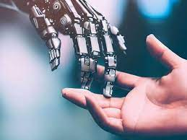
INTRODUCTION
We call ourselves Homo sapiens—man the wise—because our intelligence is so important to us. For thousands of years, we have tried to understand how we think; that is, how a mere handful of matter can perceive, understand, predict, and manipulate a world far larger and more complicated than itself.
The field of artificial intelligence, or AI, goes further still: it attempts not just to understand but also to build intelligent entities.
Department of Computer Science and Engineering - DS

Slide 4
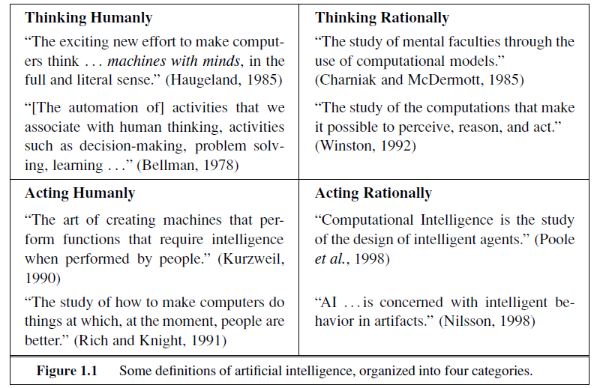
INTRODUCTION => WHAT IS AI?
In Figure 1.1 we see eight definitions of AI, laid out along two dimensions.
The definitions on top are concerned with THOUGHT PROCESSES and REASONING, whereas the ones on the bottom address BEHAVIOR.
The definitions on the left measure success in terms of fidelity to HUMAN performance, whereas the ones on the right measure against an ideal performance measure, called RATIONALITY.
A system is rational if it does the “right thing,” given what it knows.
Department of Computer Science and Engineering - DS

Slide 5
INTRODUCTION ➔ WHAT IS AI? ➔ Acting humanly: The Turing Test approach
The Turing Test, proposed by Alan Turing (1950), was designed to provide a satisfactory operational definition of intelligence. A computer passes the test if a human interrogator, after posing some written questions, cannot tell whether the written responses come from a person or from a computer
The computer would need to possess the following capabilities:
Natural Language Processing to enable it to communicate successfully in English.
Knowledge Representation to store what it knows or hears;
Automated Reasoning to use the stored information to answer questions and to draw new conclusions;
Machine Learning to adapt to new circumstances and to detect and extrapolate patterns.
Department of Computer Science and Engineering - DS

Slide 6
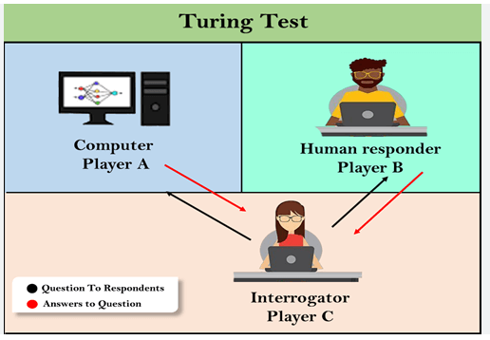
INTRODUCTION ➔ WHAT IS AI? ➔ Acting humanly: The Turing Test approach
Total Turing Test includes a video signal so that the interrogator can test the subject’s perceptual abilities, as well as the opportunity for the interrogator to pass physical objects “through the hatch.” To pass the total Turing Test, the computer will need
Computer Vision to perceive objects, and
Robotics to manipulate objects and move about.
Department of Computer Science and Engineering - AIML

Slide 7
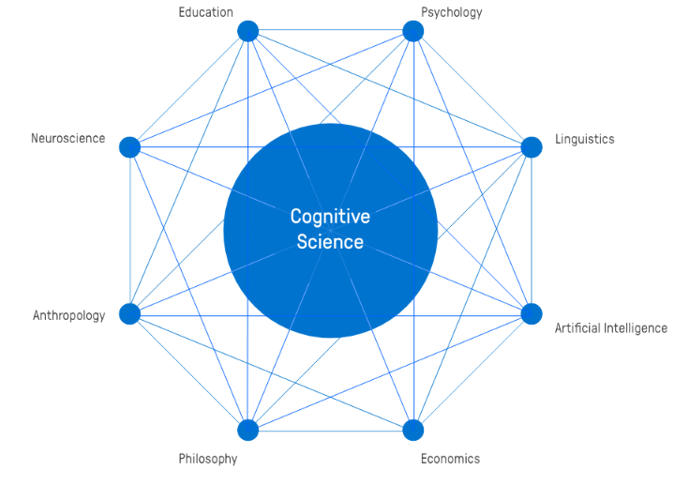
INTRODUCTION ➔ WHAT IS AI? ➔ Thinking humanly: The cognitive modeling approach
If we are going to say that a given program thinks like a human, we must have some way of determining how humans think. We need to get inside the actual workings of human minds. There are three ways to do this:
Through introspection—trying to catch our own thoughts as they go by;
Through psychological experiments—observing a person in action; and
Through brain imaging—observing the brain in action.
The interdisciplinary field of cognitive science brings together computer models from AI and experimental techniques from psychology to construct precise and testable theories of the human mind.
Department of Computer Science and Engineering - DS

Slide 8
INTRODUCTION ➔ WHAT IS AI? ➔ Thinking rationally: The “laws of thought” approach
The Greek philosopher Aristotle was one of the first to attempt to codify “right thinking,” that is, irrefutable reasoning processes. His syllogisms provided patterns for argument structures that always yielded correct conclusions when given correct premises.
For example, “Socrates is a man; all men are mortal; therefore, Socrates is mortal.”
These laws of thought were supposed to govern the operation of the mind; their study initiated the field called logic.
The so-called logicist tradition within artificial intelligence hopes to build on such programs to create intelligent systems.
There are two main obstacles to this approach:
First, it is not easy to take informal knowledge and state it in the formal terms required by logical notation, particularly when the knowledge is less than 100% certain.
Second, there is a big difference between solving a problem “in principle” and solving it in practice.
Department of Computer Science and Engineering - DS

Slide 9
INTRODUCTION ➔ WHAT IS AI? ➔ Acting rationally: The rational agent approach
An agent is just something that acts (agent comes from the Latin agere, to do).
Computer agents are expected to do:
operate autonomously,
perceive their environment,
persist over a prolonged time period,
adapt to change,
create and pursue goals.
A rational agent is one that acts so as to achieve the best outcome or, when there is uncertainty, the best expected outcome.
In the “laws of thought” approach to AI, the emphasis was on correct inferences (conclusions).
Making correct inferences is sometimes part of being a rational agent, because one way to act rationally is to reason logically to the conclusion that a given action will achieve one’s goals and then to act on that conclusion.
On the other hand, correct inference is not all of rationality; in some situations, there is no provably correct thing to do, but something must still be done.
There are also ways of acting rationally that cannot be said to involve inference.
Department of Computer Science and Engineering - DS

Slide 10
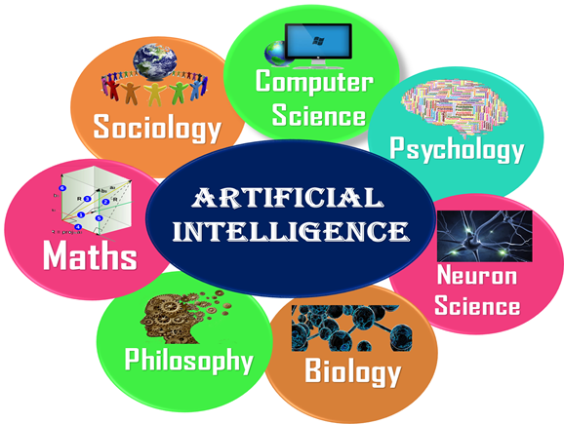
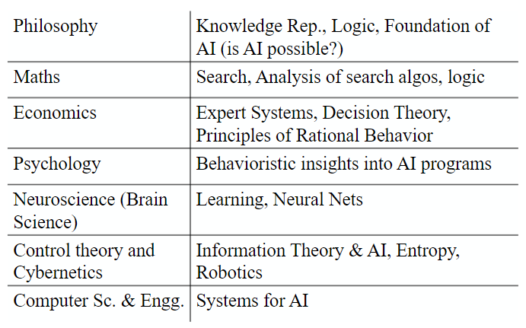
➔ THE FOUNDATIONS OF ARTIFICIAL INTELLIGENCE
Department of Computer Science and Engineering - DS

Slide 11
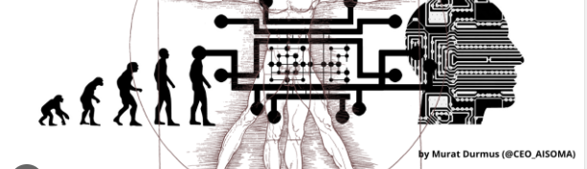
INTRODUCTION ➔ THE FOUNDATIONS OF ARTIFICIAL INTELLIGENCE ➔ Philosophy
1. Philosophy (423 BC - present):
Can formal rules be used to draw valid conclusions?
How does the mind arise from a physical brain?
Where does knowledge come from?
How does knowledge lead to action?
− Logic, methods of reasoning.
− Mind as a physical system.
− Foundations of learning, language, and rationality.
Department of Computer Science and Engineering - DS

Slide 12
INTRODUCTION ➔ THE FOUNDATIONS OF ARTIFICIAL INTELLIGENCE ➔ Mathematics
2. Mathematics (c.800 - present):
What are the formal rules to draw valid conclusions?
What can be computed?
How do we reason with uncertain information?
Three areas developed– Logic, Computation and Probability
Formal representation and proof
Development of Formal logic – 1) Propositional or Boolean logic – 2) Development of First-Order logic by extending the Boolean logic to include objects and relations
Algorithms, computation, decidability, tractability First algorithm was developed - Euclid’s algorithm for computing GCD
Probability – Baye’s rule is the underlying approach for uncertain reasoning in AI systems.
Department of Computer Science and Engineering - AIML
Department of Computer Science and Engineering - DS

Slide 13
INTRODUCTION ➔ THE FOUNDATIONS OF ARTIFICIAL INTELLIGENCE ➔ Economics
3. Economics :
How should we make decisions so as to maximize payoff?
How should we do this when others may not go along?
How should we do this when the pay off may be far in the future?
Decision theory, which combines probability theory with utility theory, provides a formal and complete framework for decisions (economic or otherwise) made under uncertainty.
Game theory included the surprising result that, for some games, a rational agent should adopt policies that are randomized.
Operational Research how to make rational decisions when payoffs from actions are not immediate but instead result from several actions taken in sequence.
Satisficing—making decisions that are “good enough,” rather than laboriously calculating an optimal decision
Department of Computer Science and Engineering - AIML
Department of Computer Science and Engineering - DS

Slide 14
INTRODUCTION ➔ THE FOUNDATIONS OF ARTIFICIAL INTELLIGENCE ➔ Neuroscience
4. Neuroscience:
The study of nervous system, particularly the brain.
The exact way in which the brain enables thought is unknown.
However, it does enable thought has the evidence.
“A strong blow to the head can lead to mental incapacitation”
Neurons – Brain consists of nerve cells or neurons.
There is no theory on how an individual memory is stored.
A collection of simple cells can lead to thought, action, consciousness that “brains cause minds”
The parts of a nerve cell or neuron.
Each neuron consists of a cell body or soma, that contains a cell nucleus.
Branching out from the cell body are a number of fibers called dendrites and a single long fiber called the axon.
A neuron makes connections with 10 to 100,000 other neurons at junctions called synapses
Department of Computer Science and Engineering - AIML
Department of Computer Science and Engineering - DS

Slide 15
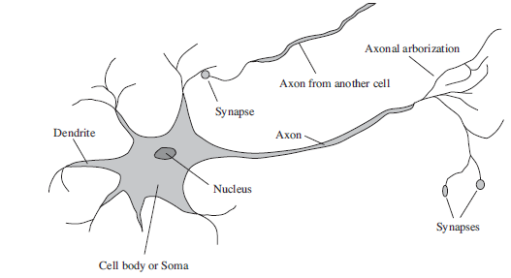
INTRODUCTION ➔ THE FOUNDATIONS OF ARTIFICIAL INTELLIGENCE ➔ Neuroscience
Signals are propagated from neuron to neuron by a complicated electrochemical reaction.
The signals control brain activity in the short term and also enable long-term changes in the connectivity of neuron.
These mechanisms are thought to form the basis for learning in the brain.
Department of Computer Science and Engineering - AIML
Department of Computer Science and Engineering - DS

Slide 16
INTRODUCTION ➔ THE FOUNDATIONS OF ARTIFICIAL INTELLIGENCE ➔ Psychology
5. Psychology (1879 - present):
How do humans and animals think and act?
− Adaptation.
− Phenomena of perception and motor control.
− Experimental techniques.
Department of Computer Science and Engineering - AIML
Department of Computer Science and Engineering - DS

Slide 17
INTRODUCTION ➔ THE FOUNDATIONS OF ARTIFICIAL INTELLIGENCE ➔ Computer Engineering
6. Computer Engineering:
How can we build an efficient computer?
For artificial intelligence to succeed, we need two things: intelligence and an artifact.
The computer has been the artifact of choice.
Each generation of computer hardware has brought an increase in speed and capacity and a decrease in price
In 2005 power dissipation problems led to multiply the number of CPU cores rather than the clock speed.
Current expectations are that future increases in power will come from massive parallelism – Convergence with the properties of the brain.
The software side of computer science has supplied AI with:
The operating systems, programming languages, and tools needed to write modem programs.
Department of Computer Science and Engineering - AIML
Department of Computer Science and Engineering - DS

Slide 18
INTRODUCTION ➔ THE FOUNDATIONS OF ARTIFICIAL INTELLIGENCE ➔ Control Theory and Cybernetics
7. Control Theory and Cybernetics:
How can artifacts operate under their own control?
Previous Assumption: Only living things could modify their behavior in response to changes in the environment.
Machines can modify their behavior in response to the environment (sense/action loop)
Ex: Water-flow regulator, steam engine governor, thermostat.
The theory of stable feedback systems (1894).
Build systems that transition from initial state to goal state with minimum energy. In 1950, control theory could only describe linear systems.
AI largely rose as a response to this shortcoming.
Department of Computer Science and Engineering - AIML
Department of Computer Science and Engineering - DS

Slide 19
INTRODUCTION ➔ THE FOUNDATIONS OF ARTIFICIAL INTELLIGENCE ➔ Linguistics
8. Linguistics (1957  present):
How does language relate to thought?
Knowledge representation: the study of how to put knowledge into a form that a computer can reason with Grammar.
Speech demonstrates human intelligence:
Analysis of human language reveals thought taking place in ways not understood in other settings. Language and thought are believed to be tightly intertwined.
Modern linguistics and AI intersect in a hybrid field called Computational Linguistics or Natural Language Processing (NLP).
Department of Computer Science and Engineering - AIML
Department of Computer Science and Engineering - DS

Slide 20
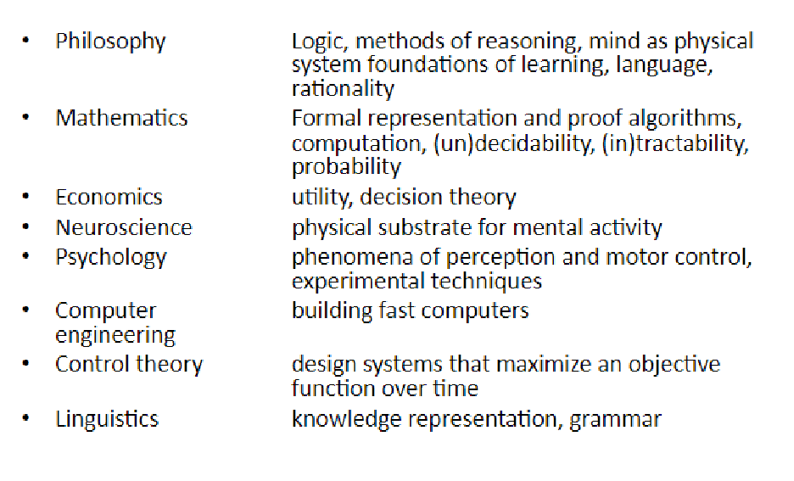
THE FOUNDATIONS OF ARTIFICIAL INTELLIGENCE
Department of Computer Science and Engineering - AIML
Department of Computer Science and Engineering - DS

Slide 21
THE HISTORY OF ARTIFICIAL INTELLIGENCE
The gestation of AI (1943 - 1956):
1943: McCulloch & Pitts: Boolean circuit model of brain.
1950: Turing’s “Computing Machinery and Intelligence”.
1956: McCarthy’s name “Artificial Intelligence” adopted.
Why was it necessary for AI to become a separate field ?
Why couldn't all the work done in AI have taken place under the name of control theory or operations research or decision theory, which have objectives similar to those of AI?
Why isn't AI a branch of mathematics?
The first answer is that AI from the start embraced the idea of duplicating human faculties such as creativity, self-improvement, and language use.
None of the other fields were addressing these issues.
The second answer is methodology. AI is the only one of these fields that is clearly a branch of computer science (USING COMPUTER SIMULATIONS).
AI is the only field to attempt to build machines that will function autonomously in complex, changing environments.
Department of Computer Science and Engineering - AIML
Department of Computer Science and Engineering - DS

Slide 22
THE HISTORY OF ARTIFICIAL INTELLIGENCE
Early enthusiasm, great expectations (1952 - 1969):
Early successful AI programs:
  Newell & Simon’s Logic Theorist.
  Newell & Simon’s General Problem Solver (GPS) to imitate human problem solving.
    Solved puzzles and considered sub goals and possible actions similar to which humans approached the same problems.
    Thus, GPS was probably the first program to embody the "thinking humanly" approach.
  Newell & Simon’s Physical symbol system hypothesis:
    which states that "a physical symbol system has the necessary and sufficient means for general intelligent action."
    Any system (human or machine) exhibiting intelligence must operate by manipulating data structures composed of symbols.
Department of Computer Science and Engineering - AIML
Department of Computer Science and Engineering - DS

Slide 23
INTRODUCTION ➔ THE HISTORY OF ARTIFICIAL INTELLIGENCE
A dose of reality (1966 - 1973):
The first kind of difficulty arose because most early programs knew nothing of their subject matter.
They succeeded by means of simple syntactic manipulations.
Early machine translation efforts to speed up the translation of Russian scientific papers in the wake of the Sputnik launch in 1957.
It was thought initially that simple syntactic transformations based on the grammars of Russian and English, and word replacement from an electronic dictionary, would suffice to preserve the exact meanings of sentences.
The fact is that accurate translation requires background knowledge in order to resolve ambiguity and establish the content of the sentence.
The second kind of difficulty was the intractability of many of the problems.
Most of the early AI programs solved problems by trying out different combinations of steps until the solution was found.
This strategy worked initially with limited objects and hence very few possible actions and very short solution sequences.
Department of Computer Science and Engineering - AIML

Slide 24
INTRODUCTION ➔ THE HISTORY OF ARTIFICIAL INTELLIGENCE
Knowledge-based systems (1969 - 1979):
Uses more powerful, domain-specific knowledge.
Allows larger reasoning steps and can more easily handle typical expertise.
Ex1 :1969: DENDRAL by Buchanan et al.
generated all possible structures consistent with the formula of the molecule
The significance of DENDRAL was that it was the first successful knowledge-intensive system.
Its expertise derived from large numbers of special-purpose rules.
Ex2: 1976: MYCIN by Shortliffle.
Expert systems in medical diagnosis With about 450 rules, MYCIN was better than junior doctors.
Department of Computer Science and Engineering - AIML

Slide 25
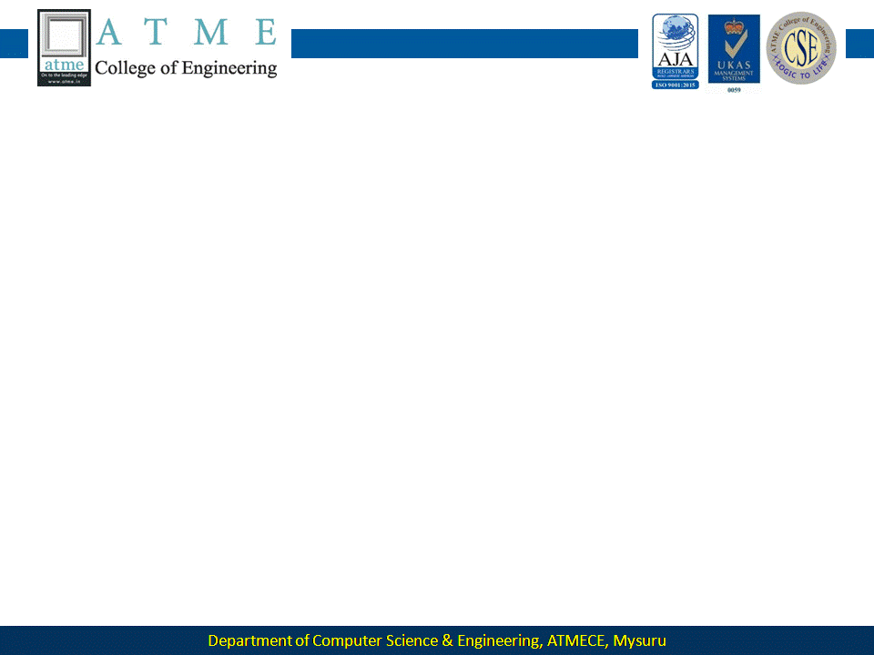
INTRODUCTION ➔ THE HISTORY OF ARTIFICIAL INTELLIGENCE
AI becomes an industry (1980 - present):
Expert systems industry booms.
1981: Japan’s 10-year Fifth Generation project to build intelligent computers.
The return of NNs (1986 - present):
Mid 80’s: Back-propagation learning algorithm reinvented.
1988: Resurgence of probability.
AI adopts the scientific method (1987 - present):
In terms of methodology, AI has finally come firmly under the scientific method.
To be accepted, hypotheses must be subjected to rigorous empirical experiments
and the results must be analyzed statistically for their importance.
It is now possible to replicate experiments by using shared repositories of test data and code.
Department of Computer Science and Engineering - AIML

Slide 26
INTRODUCTION ➔ THE HISTORY OF ARTIFICIAL INTELLIGENCE
The emergence of intelligent agents (1995- present):
One of the most important environments for intelligent agents is the Internet.
AI systems have become so common in Web-based applications that the "-bot'' suffix has entered everyday language.
Internet tools, such as search engines, recommender systems, and Web site aggregators use AI technologies.
The availability of very large data sets( 2001-present):
In the 60-year history of computer science, the emphasis has been on the algorithm as the main subject of study.
But recent work in AI suggests that for many problems, it makes more sense to worry about the data.
This is true because of the increasing availability of very large data sources.
Examples: trillions of words of English, billions of images from the Web, or billions of base pairs of genomic sequences.

Slide 27
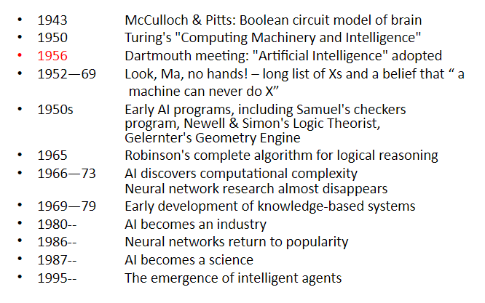
INTRODUCTION ➔ THE HISTORY OF ARTIFICIAL INTELLIGENCE

Slide 28

Discussion and Interaction
Department of Computer Science and Engineering - AIML

Slide 29

Department of Computer Science and Engineering - AIML

