Slide 1
Module – 01
IRRIGATION
WATER REQUIREMENTS OF CROPS

Slide 2
Introduction
Irrigation may be defined as the process of supplying water to fields by artificial needs for the healthy development of crops.
Basic objective of irrigation is to supplement natural supply of water to lands, so as to obtain an optimum yield from the crop grown in the fields.
Irrigation is a significant method of applying water to the crops as and when required at the required quantity.
Requirement of water by the crop varies with the type of crop and frequency of irrigation, to achieve maximum outcome from cultivation it is essential to practice the irri-gation system.
Irrigation system involves planning, design, constructing, operating and main-taining of various hydraulic structures such as dams, barriers, spillways, diversion structures, tanks, canals etc.

Slide 3
Necessity of Irrigation
India is basically an agricultural country and its resources depend on the agricultural output. Prosperity of our country depends mainly upon proper development of agriculture.
Even after 70 years of Independence, we have not succeeded in solving our food problems. The main reason for this miserable state of affair is that we still continue to remain at the mercy of rain and practice old age methods of cultivation.
Plants usually derive water from nature through rainfall. However, the total rainfall in a particular area may be either insufficient or ill timed.
In order to get the maximum yield, it is necessary to have a systematic irrigation system for supplying optimum quantity of water at correct timing.

Slide 4
Importance of irrigation can be summarized under the following four aspects:
1. Area of less rainfall: Artificial supply of water is necessary when the total rainfall is less than the water requirement of crops in such cases, irrigation works may be constructed at a place where more water is available and conveyed to water deficit areas.
Eg: The Rajasthan canal supplies water from the river Yamuna to the arid regions of Rajasthan where annual rainfall is less than 100 to 200 mm.
2. Non-Uniform rainfall: The rainfall in a particular area may not be uniform over the entire crop period. Rainfall may be there during the early period of crops and may become scanty or unavailable at the end resulting in lesser yield or total loss of the crop. Collection of water during periods of excess rainfall and supplying the stored water during periods of scarcity may prove beneficial to the farmers. Most irrigation projects in India are based on this aspect.

Slide 5
Importance of irrigation can be summarized under the following four aspects:
3. Commercial crops with additional water: The rainfall in a particular area may be sufficient to raise the usual crops but insufficient for raising commercial and cash crops such as sugarcane and cotton. In such situations, utilizing stored water by irrigation facilities is advantageous.
4. Controlled Water Supply: Dams are normally meant for storing water during excess flow periods. But in situations of heavy rainfall, flooding can be controlled by arresting the flow in the river and excess water can be released during low flow conditions.

Slide 6




1
Advantages of irrigation:
i. To increase in food production.
ii. To make most effective utilization of natural resources like water.
iii. To cultivate the crops which require more water and having more crop period.
iv. To protect from drought or famine.
v. Irrigation facilities for generation of hydroelectric power.
vi. To increase per capita income and national wealth.
vii. To provide water to meet the domestic and industrial needs.
viii. To facilitate for inland navigation, afforestation, fishery culture.
ix. Improvement in groundwater storage.
x. Greater employment opportunities.
xi. Social and economic status improves.

Slide 7
1
Disadvantages of irrigation:
i. Required to acquire huge area to construct storage structures, channel system and distribution system.
ii. Continuous irrigation practice reduces soil fertility.
iii. Inferior of food grains (low quality).
iv. Initial establishment cost is very high.
v. Water logging and breading places for mosquitoes.

Slide 8
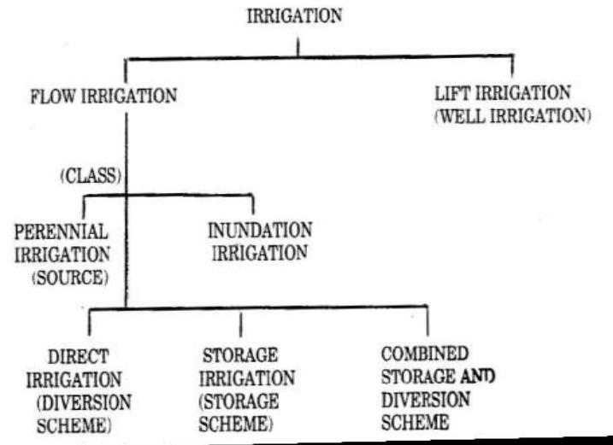
1
System of Irrigation:

Slide 9
1
Flow Irrigation
Flow irrigation is a type of irrigation in which the supply of irrigation water available is at such a level that it is conveyed to the land by the gravity flow.
Perennial Irrigation:
It is that system of irrigation in which irrigation water is supplied as per the crop requirements at regular intervals throughout the crop period. The source of irrigation water may be a perennial river, stored water in reservoirs or groundwater drawn from open wells or bore wells. This is the most commonly adopted irrigation system.

Slide 10
1
Inundation Irrigation: It is that system of irrigation in which large quantity of water flowing in a river is allowed to flood or inundate the fields to be cultivated. The land becomes thoroughly saturated. Excess water is drained off and the land is prepared for cultivation. Moisture stored in the soil is sufficient to bring the crop to maturity. Inundation irrigation is commonly prac-ticed in delta region of rivers. Canals may be also employed to inundate the fields when water is available in plenty.

Slide 11
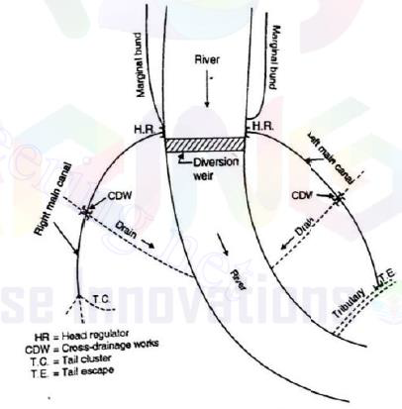
1
Direct Irrigation:
It is a type of flow irrigation in which water from rivers and streams are conveyed directly to agricultural fields through a network of canals, without making any attempt to store water this is practiced in areas where the rivers and streams are perennial.
Small diversion dams or barrages may be constructed across the rivers to raise the water level and then divert the water into canals.

Slide 12
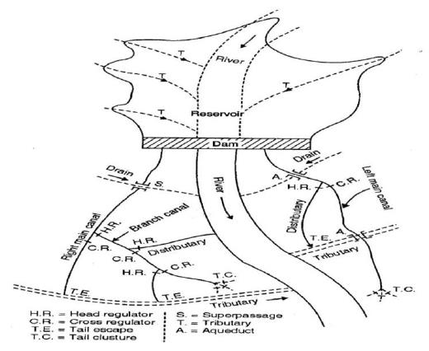
1
ii) Storage Irrigation:
Dams are constructed across rivers which are non-perennial.
The discharge in such rivers may be very high during rainy season and may become less during dry stream.
By constructing dams across such rivers, water can be stored as res-ervoir during excess flow and can be utilized or diverted to agriculture fields through canals as and when required.
Such a system is known as storage irrigation.

Slide 13
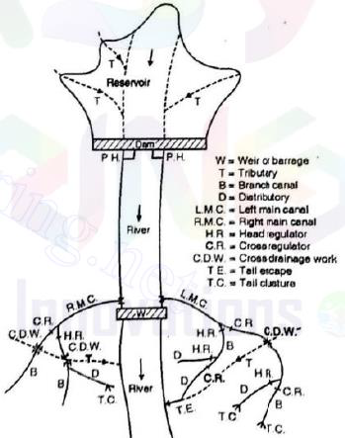
1
iii) Combined System:
A combined scheme is adopted in which the water is first stored in the reservoir formed at the upstream side of the dam, and this water is used for water power generation.
The discharge from the power house is fed back into the river, to the downstream side of the dam.
Thus, sufficient quantity of flow is again available in the river.
At a suitable location in the downstream, a pick-up weir is constructed.
This weir diverts the water from river to the canal.

Slide 14
1
Lift Irrigation
It is that system of irrigation in which irrigation water is available at a level lower than that of the land to be irrigated and hence water is lifted by pumps or other mechanism (Hydraulic ram and siphon action) and then conveyed to agriculture fields by gravity flow.
Irrigation through wells is an example of lift irrigation.
Water from canals or any other source can also be lifted when the level of water is lower than that of the area to be irrigated.

Slide 15
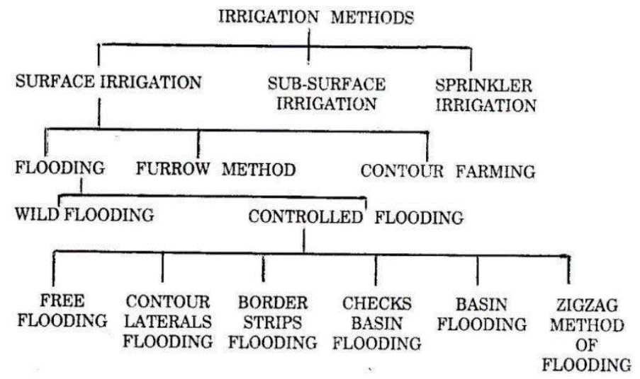
1
METHODS OF IRRIGATION

Slide 16
1
Surface Irrigation
In this method the irrigation water is applied by spreading water as a sheet or as a small stream on the land to be irrigated.
i. Flooding:
a. Wild flooding:
b. Controlled flooding:
Free flooding
Border strip method
Checks or Levees
Basin flooding
Zigzag flooding
ii. Furrow method
iii. Contour farming

Slide 17
1
i) Flooding:
In this method, water is applied by spreading over the land to be irrigated.
a. Wild flooding:
In this method water is applied by spreading water over the land to be irrigated without any preparation.
There is no restriction for the movement of water. It follows over the natural slope of the land.
The water may be applied to the land directly from a natural stream during season of high flow as in inundation irri-gation.
This method is suitable for flat and smooth land but involves wastage of water and hence it can be practiced where water is abundant and inexpensive.

Slide 18
1
b. Controlled flooding:
In this method water is applied by spreading it over the land to be irrigated with proper control over the flow of water and as well as the quantity of water to be applied. In such methods prior land preparation is essential.
1. Free flooding: This method is also known as irrigation by plots. Here the field is divided into a number of small sized plots which are practically level. Water is ad-mitted at the higher end of the plots and the water supply is cut off as soon as the water reaches the lower end of the plots.

Slide 19
1
3. Border strip method: In this method the land to be irrigated is divided into a series of long narrow strips separated from each other by levees (Earthen bunds) or bor-ders. The width of the strips varies between 10 to 20 m and the length of the strip varies between 60 to 300 m depending upon the nature of the soil and rate of water supply. The strip of the land has no cross slope and has uniform gentle slope in the longitudinal direction. This method is suitable for forage crops requiring least la-bour. Mechanized farming can be adopted in this method.

Slide 20
1
4. Checks or Levees: In this method a comparatively large stream of water discharged into a relatively level plot surrounded by check or levees or low rise bunds. The checks are usually 30cm high. The checks may be temporary for a single crop sea-son or semi-permanent for repeated used as in case of paddy fields. The size of the plots depends upon the discharge of water and porosity of the soil. The usual size of the plot varies between 0.04 hectares to 0.05 hectares.
5. Basin flooding: This method of irrigation is adopted for irrigating or chards (enclo-sures of fruit trees). For each tree, a separate basin which is circular usually is made.
However, in some cases basins are made large to include two or more trees ineach basin. Water is supplied through a separate field channel, but in some cases the basins are interconnected.

Slide 21
1
5. Zigzag flooding: This is a special method of flooding where the water takes a circuitous route before reaching the dead end of each plot. Each plot is sub divided with help of low bunds. This method is adopted in loose soils to prevent erosion at the higher ends.

Slide 22
1
ii. Furrow method
In this method water is applied to the land to be irrigated by a series of long narrow field channels called furrows. A furrow is an arrow ditch of 75 to 125 mm deep excavated between rows of plants to carry irrigation water. The spacing of furrows depends upon the spacing of the plants. The length of a furrow is usually 200metres. In this method only one fifth to one half of the surface is wetted. The evap-oration losses are very much reduced.
iii. Contour farming
Contour farming is practiced in hilly regions where, the land to be irrigated has a steep slope. Here the land is divided into a series of strips usually known as terraces or benches which are aligned to follow the contour of the sloping area. This method also helps in controlling soil erosion

Slide 23
1
Sub – Surface Irrigation
This method consists of supplying water directly to the route zone through ditches at as low rate which are 0.5 m to1 m deep and 25 to 50 cm wide. The ditches are spaced 50 to 100 m apart.
Water seeps into the ground and is available to the crop in the form of a capillary fringe.
Proper drainage of excess water is permitted either naturally or providing suitable drainage works, thereby preventing waterlogging in the favourable conditions to practice subsurface fields are
i. Availability of imperious sub soil at a reasonable depth (2 to 3 m).
ii. Water table is present at shallow depth.
iii. Availability of moderate slope.
iv. Availability of good quality irrigation water.
With the above favourable conditions and necessary precautions it is possible to achieve higher yields at low cost.

Slide 24
1
Sprinkler Irrigation
This method consists of applying water in the form of a fine spray as similar to rain fall.
Sta-tionary overhead perforated pipes or fixed nozzle pipes installations were earlier used.
How-ever, with the introduction of light weight pipes and quick couplers, portable sprinkler systems with rotating nozzle have been developed and hence these have become popular.
A pump usu-ally lifts water from the source and supplies it through the distribution system and then through the sprinkler nozzle or sprinkler head mounted on the riser pipes.
About, 80 % irrigation effi-ciency is possible with sprinkler irrigation, particularly in semi-arid and humid regions.
The efficiency of this system decreases by 5 % for every 7.5 km/hour of increase in wind velocity.

Slide 25
1
Sprinkler irrigation method is adopted in regions where, surface irrigation methods cannot be used due to the following reasons.
i. The soil is too pervious or impervious.
ii. The nature of the soil is too erosive.
iii. The topography is not uniform or very steep.
iv. The land is not suitable for surface irrigation method.

Slide 26
1
Advantages of sprinkler irrigation
i. Soil erosion is well controlled by adjusting the discharge through the nozzle.
ii. Uniform water application is possible.
iii. In case of seedlings and young plants, light irrigation is possible easily.
iv. Much land preparation is not essential and hence labour cost is reduced.
v. More land for cropping is available since borders and ditches are not required.
vi. Small amounts of irrigation water in water scarcity regions can be effectively utilized.

Slide 27
1
Disadvantages of sprinkler irrigation
i. Wind will distort the sprinkling pattern.
ii. Constant water supply under pressure is required for economic use of equipment.
iii. Irrigation water must be free from silt, sand and impurities.
iv. Initial investment is high.
v. Energy requirement for pumping water is high.
vi. Heavy soil with poor infiltration (clayey soil) cannot be irrigated efficiently.

Slide 28
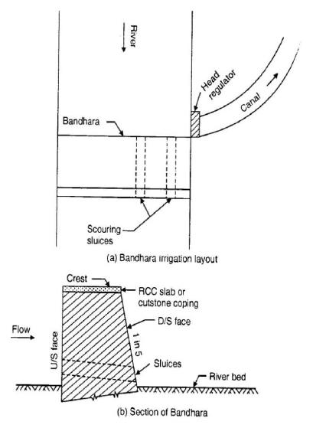
1
BANDHARA IRRIGATION
It is a special irrigation scheme adopted across small perennial rivers.
This system lies some-where between inundation type and permanent type of irrigation.
A Bandhara is a low masonry weir (obstruction) of height 1.2 m to 4.5 m constructed across the stream to divert water into a small canal.
The canal usually takes off from one side and the flow into the canal is controlled by a head regulator.

Slide 29
1
The length of the main canal is usually restricted to about 8 km. A series of Bandhara as may be constructed one below the other on the same stream so that water spilling over from one Bandhara is checked by another Bandhara.
The irrigation capacity of each Bandhara is may be about 400 hectares. Bandharas are adopted across small streams having isolated catchments
which are considered to be non-feasible or uneconomical to be included under a large irrigation scheme. This method of irrigation is followed in Central Maharashtra and is commonly known there as the `Phad’ system.

Slide 30
1
Advantages of Bandharas
i. Small quantity of flow in streams can be fully utilized or otherwise might have gone as a waste.
ii. As the length of the canal is short, seepage and evaporation losses are less.
iii. Intensive irrigation with high duty may be achieved and the area to be irrigated is close to the source.
iv. The initial investment and maintenance cost of the system is low.
Disadvantages of Bandharas
i. The supply of water is unreliable when the flow in streams becomes lesser.
ii. Excess water available cannot be utilized as area for cultivation below each Bandhara is fixed.
iii. In dry seasons, people living on the downstream side of Bandharas may be deprived of water for domestic usage.

Slide 31
1

Slide 32
1

Slide 33
1

Slide 34
1
Water Requirements of Crops

Slide 35
Water Requirements of Crops
Soil groups in India
The Indian soils may be divided into four major groups’ viz.,
(i) Alluvial soils,
(ii) Black soils,
(iii) Red soils, and
(iv) Laterite soils.
In addition to these four groups there exist another group of soils which includes forest soils, desert soils, and saline and alkali soils.

Slide 36
1
Duty, delta and base period
Duty of Water: Duty represents the irrigating capacity of a unit of water.
It is usually defined as the area of land in hectares which can be irrigated to grow a crop of one cumec of water is continuously supplied for the entire period of the crop.
Example: If 5100 hectares of land can be irrigated for growing a crop with a available discharge of 3 cumec continuously for the entire crop period, then the duty of water for this crop = 5100/3 = 1700 hectares/cumec.
Different crops require different amounts of water before their harvesting and hence duty of water varies with the crops. Duty of water is said to be high, if the area of land irrigated per cumec is large.

Slide 37
1
Delta: It is the total depth of water required by a crop during the entire crop period and is denoted as ‘Δ’
Example: A crop require 12 watering at an interval of 10 days and depth of water required in each watering is 10cms, the delta for the crop is 12x10cms=120cms=1.2m
If the crop is grown in an area of ‘A’ hectares, then the total quantity of water required is = 1.2 x A hectares-meter in a period of 120 days.

Slide 38
1
Base period: It refers to the whole period of cultivation from the time when irrigation water is first applied for preparation of the ground for planting the crop to its last watering before harvesting.
Crop Period: It is the time in days that a crop takes from the instant of its sowing to that of its harvesting.

Slide 39
1
Gross command area: It is the total area laying between the drainage boundaries which can be commanded or irrigated by a canal system.
Culturable command area: Gross command area may also contain villages, ponds, barrel lands, alkaline lands etc., and such areas are turned as unculturable area. The remaining area on which crops can be grown satisfactory is known as culturable command area.

Slide 40
1
Crop seasons of India:
Sowing of crops in irrigation of crops in India is usually done in 2 seasons, known as Crop seasons. They are
1. Kharif season
2. Rabi season

Slide 41
1
Kharif season begins with the onset of south west monsoons sowing of crops in Kharif season is done during June-July and these crops are harvested in October-November.
In Rabi season the crops are sown during September-October and harvested during march- April.
Sugarcane has a delta of about 90cms but has a period of 1 year or more. It is as such termed as a perennial crop.

