Slide 1
USER INTERFACE DESIGN
21IS733

Slide 2
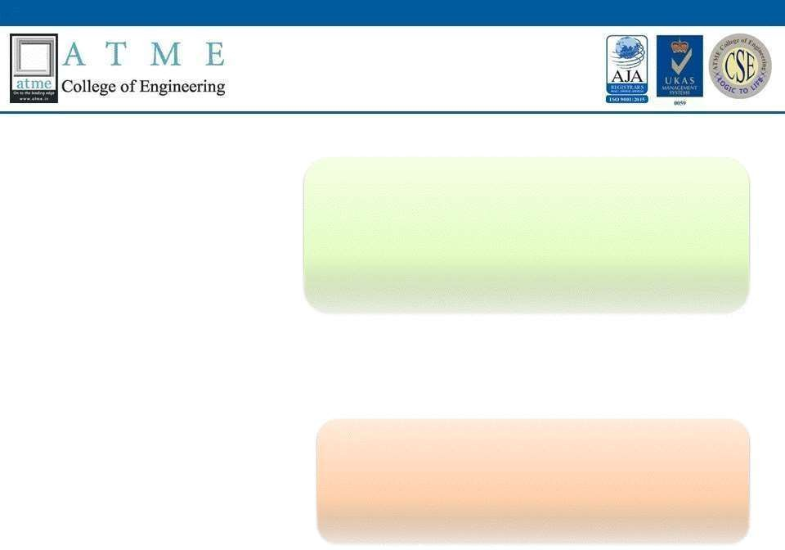
Module-1
Introduction
1

Slide 3
Defining the user interface
Types of user interfaces can include:
Form-based user interface
Graphical user interface
Menu-driven user interface
Touch user interface
Voice user interface

Slide 4
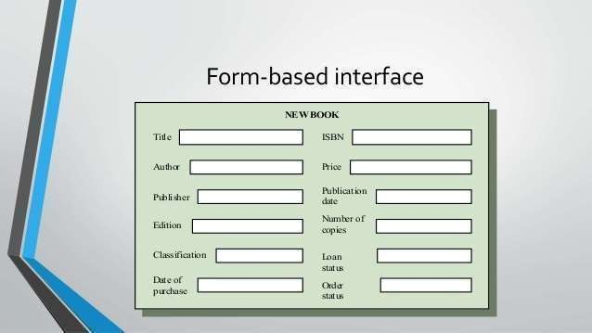

Slide 5
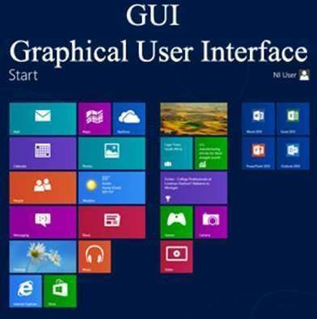

Slide 6
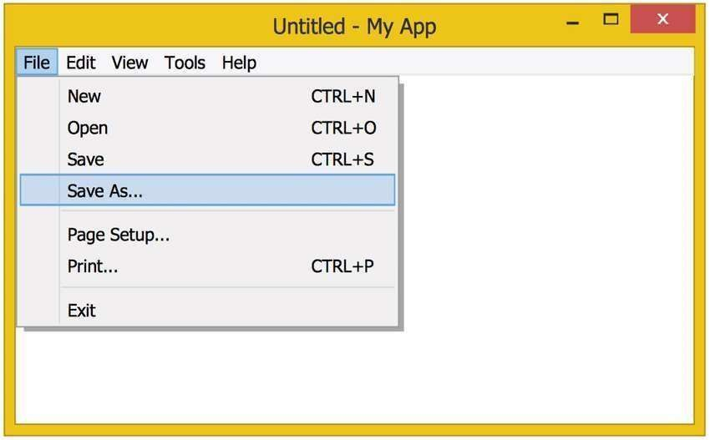

Slide 7
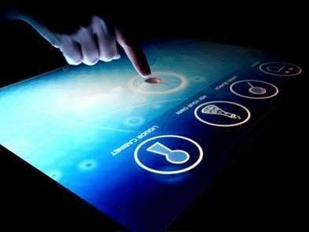

Slide 8


Slide 9
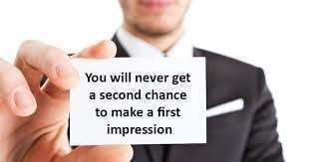

The importance of Good design
Good design makes a strong first impression

Slide 10

Good design helps your business stand out

Slide 11

Good design builds customer relationships

Slide 12

Good design keeps your website easy to use

Slide 13

Good design promotes brand consistency

Slide 14

Good design is the key to social media success.

Slide 15

Good design makes you money

Slide 16
Benefits
Increase customer acquisition and loyalty
Maximize revenue generation opportunities
Optimize resources, development time and costs
Get more insights from user engagement
Reduce troubleshooting and associated costs

Slide 17
A Brief History of the Human- Computer Interface
What is HCI
Human-computer interaction (HCI) is a multidisciplinary field of study focusing on the design of computer technology and, in particular, the interaction between humans (the users) and computers.

Slide 18
Desktops & mental models
Collaboration & communication
Self-expression, social change

Slide 19
Introduction of the Graphical User Interface
What is GUI?
is a form of user interface that allows users to interact with electronic devices
through graphical icons and audio indicator such as primary notation, instead of text- based user interfaces, typed command labels or text navigation.

Slide 20
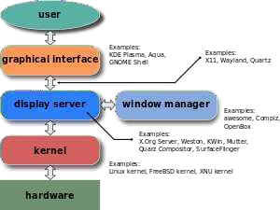

Slide 21
A GUI uses a combination of technologies and devices to provide a platform that users can interact with, for the tasks of gathering and producing information.
A series of elements conforming a visual language have evolved to represent information stored in computers. This makes it easier for people with few computer skills to work with and use computer software. The most common combination of such elements in GUIs is the windows, icons, menus, pointer (WIMP) paradigm, especially in personal computers.

Slide 22
History
1973 Pioneered at the Xerox Palo Alto Research Center.
—First to pull together all the elements of the modern GUI.
1981 First commercial marketing as the Xerox STAR.
—Widely introduced pointing, selection, and mouse.

Slide 23
1983 Apple introduces the Lisa.
— Features pull-down menus and menu bars.
1984 Apple introduces the Macintosh.
— Macintosh is the first successful mass- marketed system.
1985 Microsoft Windows 1.0 released. Commodore introduces the Amiga 1000.

Slide 24
1987 X Window System becomes widely available.
IBM’s System Application Architecture released.
— Including Common User Access (CUA).
IBM’s Presentation Manager released.
— Intended as graphics operating system replacement for DOS.
Apple introduces the Macintosh II.
— The first color Macintosh.

Slide 25
1989 UNIX-based GUIs released.
Open Look by AT&T and Sun Microsystems.
—Innovative appearance to avoid legal challenges.
—Motif, for the Open Software Foundation by DEC and Hewlett-Packard.
Appearance and behavior based

Slide 26
1993 Microsoft Windows NT released.
1995 Microsoft Windows 95 released.
1997 Apple releases the Mac OS 8.
1998 Microsoft introduces Windows 98.
1999 Apple releases Mac OS X Server.
— A UNIX-based OS.
2000 Microsoft Windows 2000 released.
Microsoft Windows ME released
2001 Microsoft Windows XP released

Slide 27
Characteristics of Graphical and Web User
Interfaces

Slide 28
The Graphical User Interface
A user interface, as recently described, is a collection of techniques and mechanisms to interact with something. In a graphical interface, the primary interaction mechanism is a pointing device of some kind.
This device is the electronic equivalent to the human hand. What the user interacts with is a collection of elements referred to as objects. They can be seen, heard, touched, or otherwise perceived. Objects are always visible to the user and are used to perform tasks.

Slide 29
The Popularity of Graphics
Graphics revolutionized design and the user interface. The older text-based screen possessed a one-
dimensional, text-oriented, form-like quality, graphic
look.
screens assumed
a three-dimensional
in windows, small rectangular
Information floated
boxes seemed to rise above the background plane. Windows could also float above other windows.
Controls appeared to rise above the screen and move when activated. Lines appeared to be etched into the screen.

Slide 30
The Popularity of Graphics
Screen navigation and commands are executed through menu bars and pull-downs.
Menus “pop up” on the screen. In the screen body, selection fields such as radio buttons, check boxes, list boxes, and palettes coexisted with the reliable old text entry field. More sophisticated text entry fields with attached or drop-down menus of alternatives also became available. Screen objects and actions were selected through use of pointing mechanisms, such as the mouse or joystick, instead of the traditional keyboard.

Slide 31
The Popularity of Graphics
Increased computer power and the vast improvement in the display enable the user’s actions to be reacted to quickly, dynamically, and meaningfully. This new interface is characterized as representing one’s “desktop” with scattered notes, papers, and objects such as files, trays, and trashcans arrayed around the screen. It is sometimes referred to as the WIMP interface: windows, icons, menus, and pointers.

Slide 32
The Concept of Direct Manipulation
graphical systems was first used by Shneiderman (1982). He called them “direct manipulation” systems, suggesting that they possess the following characteristics:
The system is portrayed as an extension of the real world. It is assumed that a person is already familiar with the objects and actions in his or her environment of interest.
The system simply replicates them and portrays them on a different medium, the screen.

Slide 33
Continuous visibility of objects and actions.
Like one’s desktop, objects are continuously
visible. Reminders of actions to be performed are also obvious, labeled buttons replacing complex syntax and command names.

Slide 34
Actions are rapid and incremental with visible display of results.
Incremental actions are easily reversible. Finally, actions, if discovered to be incorrect
or not desired, can be easily undone.

Slide 35
Earlier Direct Manipulation Systems
Indirect Manipulation
Direct manipulation of all screen objects and actions may not be feasible because of the following:
The operation may be difficult to conceptualize in the graphical system. The graphics capability of the system may be limited. The amount of space available for placing manipulation controls in the window border may be limited.

Slide 36
Graphical Systems: Advantages and
Disadvantages
Advantages
Symbols recognized faster than text.
Faster learning.
Faster use and problem solving.
Easier remembering.
More natural.
Exploits visual/spatial cues.

Slide 37
Fosters more concrete thinking.
Provides context.
Fewer errors.
Increased feeling of control.
Immediate feedback.
Predictable system responses.
Easily reversible actions.

Slide 38
Less anxiety concerning use.
More attractive.
May consume less space.
Replaces national languages.
Easily augmented with text displays.
Low typing requirements.
Smooth transition from command language system.

Slide 39
Disadvantages
Greater design complexity.
Learning still necessary
Lack of experimentally-derived design guidelines.
Inconsistencies in technique and terminology.
Working domain is the present.

Slide 40
Not always familiar.
Human comprehension limitations.
Window manipulation requirements.
Production limitations.
Few tested icons exist.
Inefficient for touch typists.
Inefficient for expert users.

Slide 41
Not always the preferred style of interaction.
Not always fastest style of interaction.
Increased chances of clutter and confusion.
The futz and fiddle factor.
May consume more screen space.
Hardware limitations.

Slide 42
Characteristics of the Graphical User Interface
Sophisticated Visual Presentation
Pick-and-Click Interaction
Restricted Set of Interface Options
Visualization
Object Orientation

Slide 43
Properties or Attributes of Objects
Actions
The following is a typical property/attribute specification sequence:
1. The user selects an object—for example, several words of text.
2. The user then selects an action to apply to that object, such as the action BOLD.
3. The selected words are made bold and will remain bold until selected and changed again.

Slide 44
Application versus Object or Data Orientation
An application-oriented approach takes an action:object approach, like this:
Action> 1. An application is opened (for example, word processing).
Object> 2. A file or other object selected (for example, a memo).
An object-oriented object:action approach does this: Object> 1. An object is chosen (a memo).
Action> 2. An application is selected (word processing).

Slide 45
Views
Views are ways of looking at an object’s information. IBM’s SAA CUA describes four
kinds of views: composed, contents, settings, and help.

Slide 46
The Web User Interface
What is Web Interface?
Troubleshooting Web Interface Access
Accessing Your Web Interface

Slide 47


Characteristics of a Web Interface
GUI versus Web Page Design
Devices
User focus.
Data/information.
User tasks.
User’s conceptual space.
Presentation elements.
Navigation.

Slide 48
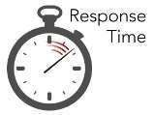
Context
Interaction.
Response time
Visual style
System capability
Task efficiency

Slide 49
User assistance.
Integration.
Security.
Reliability.

Slide 50
GUI vs WEB
 | GUI | WEB
Devices | Hardware limited | Hardware enormous
User focus | Data and App | Information and navigation
Data / Info | Trusted source | Unknown content
User tasks | Install , configure | Link to site
Presentation elements | Windows, Menus | Browser and page
Navigation | Menus, lists, tree | Links, bookmarks
Context | Restricted navigation | Unlimited navigation paths.
Interaction | Clicking menu | In a single click
Response time | Instantaneous | Quite variable

Slide 51
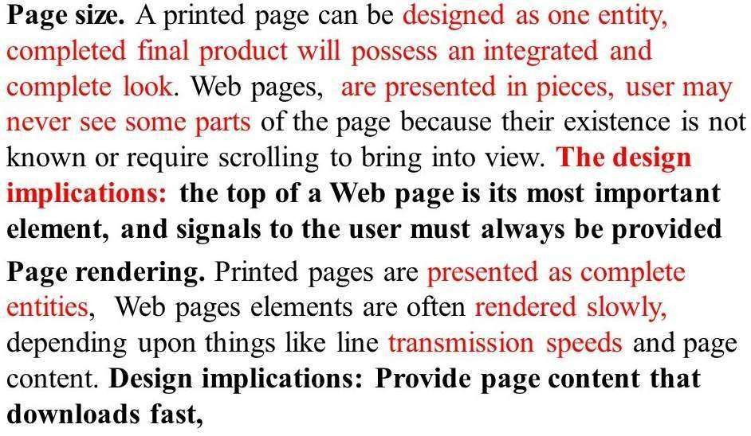
Printed pages vs web pages

Slide 52
Printed Pages versus Web Pages
Page size.
Page rendering
Page layout.
Page resolution.
User focus.
Page navigation.
Sense of place.
Interactivity.
Page independence.

Slide 53
Page size
Printed pages are generally larger than their Web counterparts. They are
also fixed in size, not variable like Web pages. A printed page can be designed as
one entity, the designer being assured that the completed final product will possess
an integrated and complete look.

Slide 54
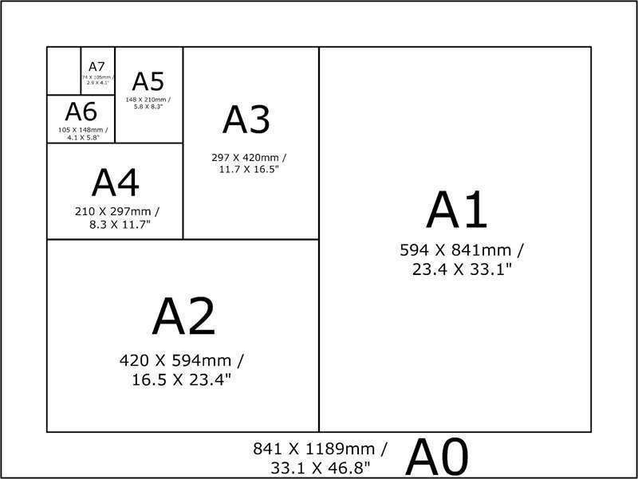

Slide 55
Page rendering
Printed pages are immensely superior to Web pages in rendering.
Printed pages are presented as complete entities, and their entire contents are
available for reading or review immediately upon appearance.

Slide 56
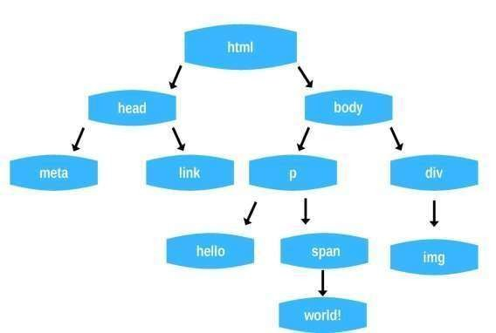

Slide 57
Page layout
Web pages layout is more of an approximation, being negatively influenced
by deficiencies in design toolkits and the characteristics of the user’s
browser and hardware, particularly screen sizes.

Slide 58
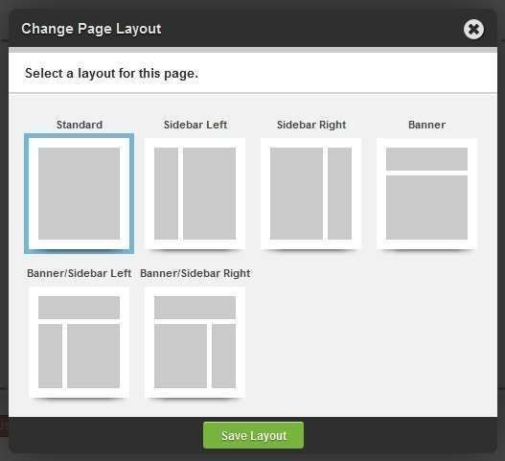

Slide 59
Page resolution
Today, the resolution of displayed print characters still exceeds that
of screen characters, and screen reading is still slower than reading from a document.

Slide 60
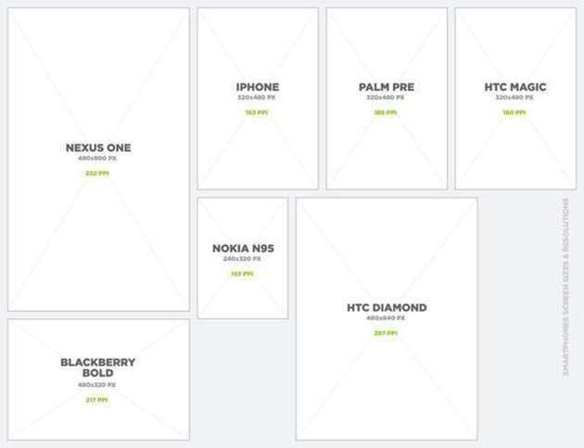

Slide 61
User focus
Printed pages present people with entire sets of information. Estimations
of effort needed to deal with the document are fairly easily made, size and
the nature of the material being strong contributors

Slide 62
Page navigation
Navigating printed materials is as simple as page turning. It is a
motor skilled learned early in life and never thought of as navigation or a design element.

Slide 63
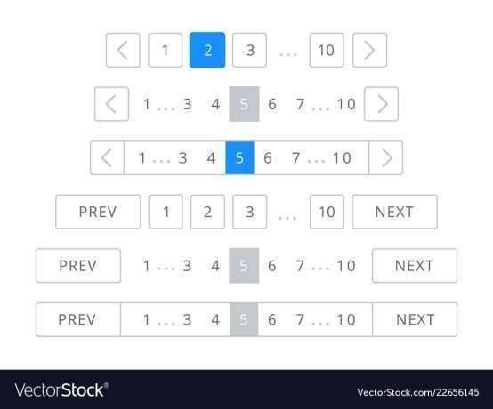

Slide 64
Sense of place
With paper documents you derive a sense of where you are through
a mixture of graphic and editorial organization, and size cues supplied by the design
of the document.

Slide 65
Interactivity
Printed page design involves letting the eyes traverse static information,
selectively looking at information and using spatial combinations to make
page elements enhance and explain each other.

Slide 66
Page independence
Because moving between Web pages is so easy, and almost any
page in a site can be accessed from anywhere else, pages must be made freestanding.

Slide 67
Characteristics of an Intranet versus the Internet
Users.
Tasks.
Type of information.
Amount of information.
Hardware and software.
Design philosophy.

Slide 68
Extranets
An extranet is a special set of intranet Web pages that can be accessed from outside an
organization or company.

Slide 69
Principles of User Interface Design
Principles for the Xerox STAR
The illusion of manipulable objects.
Visual order and viewer focus
Revealed structure
Consistency.
Appropriate effect or emotional impact.
A match with the medium

Slide 70
The Xerox
Star workstation, officially
named Xerox 8010 Information System, was the first commercial personal computer to incorporate technologies that have since
become including based interface, button),
standard in personal computers,
a bitmapped
display, a
window-
user
graphical
folders, mouse
icons,
(two-
file
Ethernet networking,
servers, print servers, and e-mail.

Slide 71
General Principles
The design goals in creating a user interface are
Aesthetically Pleasing
Provide visual appeal by following these presentation and graphic design principles:
—Provide meaningful contrast between screen elements.
Create groupings.
Align screen elements and groups.
Provide three-dimensional representation.
Use color and graphics effectively and simply.

Slide 72
Clarity
The interface should be visually, conceptually, and linguistically clear, including:
Visual elements
Functions
Metaphors
Words and text

Slide 73
Compatibility
Provide compatibility with the following:
The user
The task and job
The product
Adopt the user’s perspective.

Slide 74
Compatibility
User compatibility.
Design must be appropriate and compatible with the needs of the user or client. Effective design starts with understanding the user’s needs and adopting the user’s point of view.

Slide 75
Task and job compatibility. The organization of a system should match the tasks a person must do to perform the job. The structure and flow of functions should permit easy transition between tasks.
The user must never be forced to navigate between applications or many screens to complete routine daily tasks.

Slide 76
Product compatibility. The intended user of a new system is often the user of other
systems or earlier versions of the new system. Habits, expectations, and a level of knowledge have been established and will be brought to bear when learning the new system.
If these habits, expectations, and knowledge cannot be applied to the new system, confusion results and learning requirements are greatly increased.

Slide 77
Comprehensibility
A system should be easily learned and understood. A user should know the following:
What to look at
What to do
When to do it
Where to do it
Why to do it
How to do it
The flow of actions, responses, visual presentations, and information should be in a
sensible order that is easy to recollect and place in context.

Slide 78
Configurability
Permit easy personalization, configuration, and reconfiguration of settings.
Enhances a sense of control.
Encourages an active role in understanding.

Slide 79
Consistency
A system should look, act, and operate the same throughout. Similar components
should:
Have a similar look.
Have similar uses.
Operate similarly.
The same action should always yield the same result.
The function of elements should not change.
The position of standard elements should not change.

Slide 80
In addition to increased learning requirements, inconsistency in design
has a number of other prerequisites and by-products, including:
More specialization by system users.
Greater demand for higher skills.
More preparation time and less productiontime.
More frequent changes in procedures.
More error-tolerant systems (because errors are more likely).
More kinds of documentation.
More time to find information in documents.
More unlearning and learning when systems are changed.
More demands on supervisors and managers.
More things to do wrong.

Slide 81
Control
The user must control the interaction.
Actions should result from explicit user requests.
Actions should be performed quickly.
Actions should be capable of interruption or termination.
The user should never be interrupted for errors.
The context maintained must be from the perspective of the user.
The means to achieve goals should be flexible and compatible with
the user’s skills,
experiences, habits, and preferences.
Avoid modes since they constrain the actions available to the user.
Permit the user to customize aspects of the interface, while always
providinga
proper set of defaults.

Slide 82
Directness
Provide direct ways to accomplish tasks.
— Available alternatives should be visible.
—The effect of actions on objects should be visible.

Slide 83
Efficiency
Minimize eye and hand movements, and other control actions.
—Transitions between various system controls should flow easily and freely.
—Navigation paths should be as short as possible.
—Eye movement through a screen should be obvious and sequential.

Slide 84
Familiarity
Employ familiar concepts and use a language that is familiar to the user.
■ Keep the interface natural, mimicking the user’s behavior patterns.
■ Use real-world metaphors.

Slide 85
Flexibility
A system must be sensitive to the differing needs of its users, enabling a level and
type of performance based upon:
Each user’s knowledge and skills.
Each user’s experience.
Each user’s personal preference.
Each user’s habits.
The conditions at that moment.

Slide 86
Forgiveness
Tolerate and forgive common and unavoidable human errors.
Prevent errors from occurring whenever possible.
Protect against possible catastrophic errors.
When an error does occur, provide constructive messages.

Slide 87
Predictability
The user should be able to anticipate the natural progression of each task.
—Provide distinct and recognizable screen elements.
—Provide cues to the result of an action to be performed.
All expectations should be fulfilled uniformly and completely.

Slide 88
Recovery
A system should permit:
—Commands or actions to be abolished or reversed.
—Immediate return to a certain point if difficulties arise.
Ensure that users never lose their work as a result of:
— An error on their part.
—Hardware, software, or communication problems.

Slide 89
Responsiveness
The system must rapidly respond to the user’s requests.
Provide immediate acknowledgment for all user actions:
Visual.
Textual.
Auditory.

Slide 90
Simplicity
Provide as simple an interface as possible.
Five ways to provide simplicity:
— Use progressive disclosure, hiding things until they are needed.
Present common and necessary functions first.
Prominently feature important functions.
Hide more sophisticated and less frequently used functions.
Providedefaults.
Minimize screen alignment points.
Make common actions simple at the expense of uncommon actions
being made
harder.
Provide uniformity and consistency.

Slide 91
There are several ways to minimize this complexity.
Progressive disclosure
Provide defaults.
Minimize screen alignment points
Make common actions simple.
Provide uniformity and consistency

Slide 92
Transparency
Permit the user to focus on the task or job, without concern for the mechanics of the
interface.
— Workings and reminders of workings inside the computer should be invisible to
the user.

Slide 93
Trade-Offs
Final design will be based on a series of trade- offs balancing often-conflicting design
principles.
People’s requirements always take precedence over technical requirements.

Slide 94
Module-2
The User Inerface Design Process
1

Slide 95
Obstacles and Pitfalls in the Development Path
Developing a computer system is never easy. The path is littered with obstacles and traps, many of them human in nature. Gould (1988) has made these general observations about design:

Slide 96
Nobody ever gets it right the first time.
Development is chock-full of surprises.
Good design requires living in a sea of changes.
Making contracts to ignore change will never eliminate the need for change.
Even if you have made the best system humanly possible, people will still make mistakes when using it.
Designers need good tools.
You must have behavioral design goals like performance design goals.

Slide 97
Pitfalls
Pitfalls in the design process exist because of a flawed design process, including a failure to address critical design issues, an improper focus of attention, or development team organization failures. Common pitfalls are:

Slide 98
No early analysis and understanding of the user’s needs and expectations.
A focus on using design features or components that are “neat” or “glitzy.”
Little or no creation of design element prototypes.
No usability testing.
No common design team vision of user interface design goals.
Poor communication between members of the development team.

Slide 99
Designing for People: The Five Commandments
The complexity of a graphical or Web interface will always magnify any problems that do occur.
Gain a complete understanding of users and their tasks. The users are the customers.
Today, people sophistication Web sites.
expect a level of design from all interfaces,including

Slide 100
Solicit early and ongoing user involvement. Involving the users in design from the beginning provides a direct conduit to the knowledge they possess about jobs, tasks, and needs.
Perform rapid prototyping and testing. Prototyping and testing the product will quickly identify problems and allow you to develop solutions. The design process is complex and human behavior is still not well understood.
Modify and iterate the design as much as necessary. While design will proceed through a series of stages, problems detected in one stage may force the developer to revisit a previous stage.

Slide 101
Integrate the design of all the system components. The software, the documentation, the help function, and training needs are all important elements of a graphical system or Web site and all should be developed concurrently.

Slide 102
Usability
Bennett (1979) was the first to use the term usability to describe the effectiveness of human performance. In the following
years a more formal definition was proposed by
(1981) and modified by Bennett (1984).
Usability Assessment in the Design Process
Shackel
Usability assessment should begin in the early stages of the product development cycle and should be continually applied throughout the process.

Slide 103
Common Usability Problems
1. Ambiguous menus and icons.
2. Languages that permit only single-direction movement through a system.
Input and direct manipulation limits.
Highlighting and selection limitations.
Unclear step sequences.
More steps to manage the interface than to perform tasks.
Complex linkage between and within applications.
Inadequate feedback and confirmation.
Lack of system anticipation and intelligence.
Inadequate error messages, help, tutorials, and documentation.

Slide 104
Web usability characteristics particularly wasteful of people’s time, and often quite irritating, are:
Visual clutter. A lack of “white space,” meaningless graphics, and unnecessary and wasteful decoration often turn pages into jungles of visual noise.
Impaired information readability. Page readability is diminished by poor
developer choices in typefaces, colors, and graphics.
Incomprehensible components. Some design elements give the user no clue as to their function, leaving their purpose not at all obvious. Some icons and graphics, for example, are shrouded in mystery, containing no text to explain what they do.

Slide 105
Annoying distractions. Elements constantly in motion, scrolling marquees or text, blinking text, or looping continually running animations compete with meaningful content for the user’s eye’s and attention—and destroy a page’s readability.
Confusing navigation. A site’s structure often resembles a maze of twisting pages into which the user wanders and is quite soon lost. Poor, little, or no organization exists among pages

Slide 106
Usability is nothing but common sense.
Inefficient navigation.
Inefficient operations
Excessive or inefficient page scrolling.
Information overload.
Design inconsistency.
Outdated information.
Stale design caused by emulation of printed documents and past systems.

Slide 107
Some Practical Measures of Usability
Usability, or the lack thereof, can often be sensed by a simple observation of, or talking to, people using an interface. While these measures lack scientific rigor, they do provide an indication that there may be usability problems.
Are people asking a lot of questions or often reaching for a manual?
Are frequent exasperation responses heard?
Are there many irrelevant actions being performed?
Are there many things to ignore?
Do a number of people want to use the product?

Slide 108
Some Objective Measures of Usability
Shackel (1991) presents the following more objective criteria for measuring usability.
How effective is the interface? Can the required range of tasks be accomplished:
At better than some required level of performance (for example, in terms of speed and
errors)?
By some required percentage of the specified target range of users?
Within some required proportion of the range of usage environments?
How learnable is the interface? Can the interface be learned:
Within some specified time from commissioningand start of user training?
Based on some specified amount of training and user support?
Within some specified relearning time each time for intermittent users?
How flexible is the interface? Is it flexible enough to:
Allow some specified percentage variation in tasks and/or environments beyond those first specified?
What are the attitudes of the users? Are they:
Within acceptable levels of human cost in terms of tiredness, discomfort, frustration, and
personal effort?
Such that satisfaction causes continued and enhanced usage of the system?

Slide 109
The Design Team
Provide a balanced design team, including specialists in:
Development
Human factors
Visual design
Usability assessment
Documentation
Training

Slide 110
Effective design and development requires the application of very diverse talents.
No one person possesses all the skills to perform all the necessary tasks; the best that can be hoped for is that one person may possess a couple of skills.

Slide 111
Important Human Characteristics in Design
A variety of attributes that have an important influence on interface and screen design. Of particular importance in design are perception, memory, visual acuity, foveal and peripheral vision, sensory storage, information processing, learning, skill, and individual differences.

Slide 112
Perception
Perceptual characteristics include the following:
Proximity.
Similarity.
Matching patterns.
Succinctness.
Closure.
Unity.

Slide 113
Continuity.
Balance.
Expectancies.
Context.
Signals versus noise.

Slide 114
Memory
Memory is not the most stable of human attributes, as anyone who has forgotten why they walked into a room, or forgotten a very important birthday, can attest. Today, memory is viewed as consisting of two components
long-term and short-term
Short-term, or working, memory receives information from either the senses or longterm memory, but usually cannot receive both at once, the senses being processed separately.
Long-term memory contains the knowledge we possess. Information received in short-term memory is transferred to it and encoded within it, a process we call learning.

Slide 115
General ways to reduce user memory loads, reduce the need for mental integration, and expand working memory, thus enhancing system usability include:
Presenting information in an organized, structured, familiar,
and meaningful way.
Placing all required information for task performance in close physical proximity.
Giving the user control over the pace of information presentation.

Slide 116
Sensory Storage
Sensory storage is the buffer where the automatic processing of information collected
from our senses takes place. It is an unconscious process, large, attentive to the environment,
quick to detect changes, and constantly being replaced by newly gathered stimuli.

Slide 117
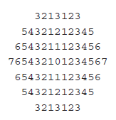
Visual Acuity
The capacity of the eye to resolve details is called visual acuity. It is the phenomenon that results in an object becoming more distinct as we turn our eyes toward it and rapidly losing distinctness as we turn our eyes away—that is, as the visual angle from the point of fixation increases.

Slide 118
Foveal and Peripheral Vision
Foveal vision is used to focus directly on something; peripheral vision senses anything in the area surrounding the location we are looking at, but what is there cannot be clearly
resolved because of the limitations in visual acuity just described.

Slide 119
Information Processing
The information that our senses collect that is deemed important enough to do something about then has to be processed in some meaningful way.
two levels of information processing.
highest level
lower level

Slide 120
Mental Models
A mental model is simply an internal representation of a person’s current understanding of something. Usually a person cannot describe this mental mode and most often is unaware it even exists. Mental
models are
gradually something,
developed in order to explain things, make
understand
decisions, do something, or interact with another person.

Slide 121
Movement Control
Once data has been perceived and an appropriate action decided upon, a response must be made; in many cases the response is a movement. In
computer activities as
systems, movements include such pressing keyboard keys, moving the
screen pointer by pushing a mouse or rotating a trackball, or clicking a mouse button.

Slide 122
Learning
Learning can be enhanced if it:
Allows skills acquired in one situation to be used in another somewhat like it. Design consistency accomplishes this.
Provides complete and prompt feedback.
Is phased, that is, it requires a person to know only the information needed at that stage of the learning process.

Slide 123
Skill
Skills are hierarchical in nature, and many basic skills may be integrated to form increasingly
complex ones. Lower-order become routine and may
skills drop
tend to
out of
consciousness. System and screen design must permit development of increasingly skillful performance.

Slide 124
Individual Differences
Individual differences complicate design because the design must permit people with widely varying characteristics to satisfactorily and comfortably learn the task or job, or use the Web site.

Slide 125
Human Interaction Speeds
Reading.
Listening.
Speaking.
Keying.
Hand printing.

Slide 126
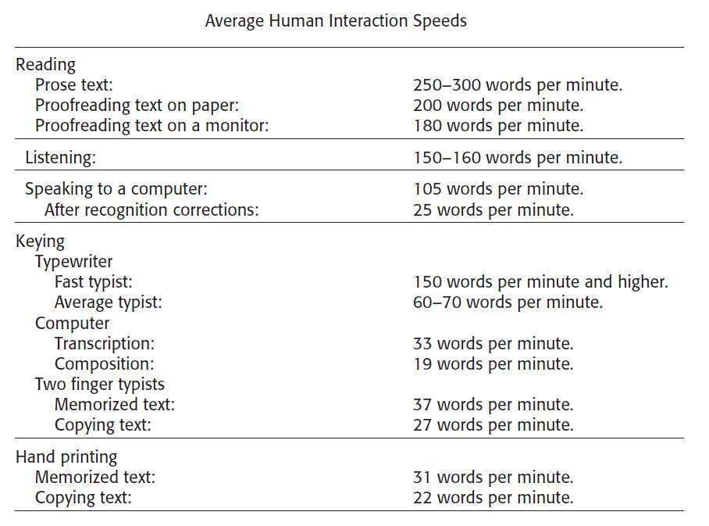

Slide 127
Business Definition and Requirements Analysis
Some Techniques for Determining Requirements
Individual Face-to-Face Interview
A one-on-one visit with the user to obtain information. It may be structured or
somewhat open-ended.
Telephone Interview or Survey
A structured interview conducted via telephone.
Traditional Focus Group
A small group of users and a moderator brought together to verbally discuss the
requirements.
Facilitated Team Workshop
A facilitated, structured workshop held with users to obtain requirements
information. Similar to the Traditional Focus Group. Observational Field Study

Slide 128
DIRECT METHODS
Users are observed and monitored for an extended time to learn what they do. Requirements Prototyping
A demo, or very early prototype, is presented to users for comments concerning
functionality.
User-Interface Prototyping
A demo, or early prototype, is presented to users to uncover user-interface issues and problems.
Usability Laboratory Testing
Users at work are observed, evaluated, and measured in a specially constructed
laboratory.
Card Sorting for Web Sites
A technique to establish groupings of information for Web sites.

Slide 129
INDIRECT METHODS
MIS Intermediary
A company representative defines the user’s goals and needs to designers and developers.
Paper Survey or Questionnaire
A survey or questionnaire is administered to a sample of users using traditional mail methods to obtain their needs.
Electronic Survey or Questionnaire
A survey or questionnaire is administered to a sample of users using e-mail or the Web to obtain their needs.
Electronic Focus Group
A small group of users and a moderator discuss the requirements online using
workstations.
Marketing and Sales
Company representatives who regularly meet customers obtain suggestions or
needs, current and potential.
Support Line
Information collected by the unit that helps customers with day-to-day problems is analyzed (Customer Support, Technical Support, Help Desk, etc.).

Slide 130
INDIRECT METHODS
E-Mail or Bulletin Board
Problems, questions, and suggestions from users posted to a bulletin board or
through e-mail are analyzed. User Group
Improvements are suggestedby customer groupswho conveneperiodically to
discuss software usage. Competitor Analyses
A review of competitor’sproducts or Web sites is used to gather ideas, uncover
design requirements and identify tasks. Trade Show
Customersat a trade show are presenteda mock-up or prototypeand askedfor
comments.
Other Media Analysis
An analysis of how other media, print or broadcast,present the process, information,
or subject matter of interest. System Testing
New requirements and feedback are obtainedfrom ongoingproduct testing

Slide 131
Individual Face-to-Face Interview
The activities performed in completing a task or achieving a goal or objective.
The methods used to perform an activity.
What interactions exist with other people or systems.
It is also very useful to also uncover any:
Potential measures of system usability
Unmentioned exceptions to standard policies or procedures.
Relevant knowledge the user must possess to perform the activity.
If designing a Web site, the following kinds of interview questions are appropriate

Slide 132
Telephone Interview or Survey
This interview is conducted using the telephone. It must have structure and be well
planned. Arranging the interview in advance allows the user to prepare for it. Telephone
interviews are less expensive and less invasive than personal interviews.

Slide 133
Traditional Focus Group
Setting up focus group involves the
following:
Establish the objectives of the session.
Select participants representing typical users, or potential users.
Write a script for the moderator to follow.
Find a skilled moderator to facilitate discussion, to ensure that the
discussion remains
focused on relevant topics, and to ensure that everyone
participates.
Allow the moderatorflexibility in using the script.
Take good notes, using the session recording for backup and clarification.

Slide 134
Facilitated Team Workshop
A facilitated team workshop is similar in structure and content to a traditional focus
group but is slightly less formal. A common technique used in system requirements determination
for many years, it is now being replaced (at least in name) by focus groups.

Slide 135
Observational Field Study
To see and learn what users actually do, they are watched and followed in their own
environment, office, or home, in a range of contexts for a period of time. Observation
provides good performed, the conditions,
insight into tasks working environment
being
and
the social environment, and working practices

Slide 136
Requirements Prototyping
A demonstration model, or very early prototype, is presented to users for their comments concerning functionality.

Slide 137
User-Interface Prototyping
A demonstration model, or early prototype, is presented to users to uncover userinterface
issues and problems.
Usability Laboratory Testing
A special laboratory is constructed and users brought in to perform actual newly designed
tasks. They are observed and results measured, and evaluated to establish the
usability of the product at that point in time.

Slide 138
Indirect Methods
An indirect method of requirements determination is one that places an intermediary between the developer and the user.
MIS Intermediary
Paper Survey or Questionnaire
Electronic Survey or Questionnaire
Electronic Focus Group Similar
Marketing and Sales
Support Line
E-Mail, Bulletin Boards or Guest Book

Slide 139
Indirect Methods
User Group
Competitor Analysis
Trade Show
Other Media Analysis
System Testing

Slide 140
Determining Basic Business Functions
Understanding the User’s Mental Model
Performing a Task Analysis
User activities are precisely described in a task analysis. Task analysis involves breaking down the user’s activities to the individual task level.
Work activities are studied and/or described by users using the techniques just reviewed; direct observation, interviews, questionnaires, or obtaining measurements of actual current system usage.

Slide 141
Developing Conceptual Models
Guidelines for Designing Conceptual Models
Reflect the user’s mental model, not the designer’s.
Draw physical analogies or present metaphors.
Comply with expectancies, habits, routines, and stereotypes.
Provideaction-response compatibility.
Make invisible parts and process of a system visible.
Provideproper and correct feedback.
Avoid anything unnecessary or irrelevant.
Provide design consistency.
Provide documentation and a help system that will reinforce the
conceptual model.
Promote the development of both novice and expert mental models.

Slide 142
Provide proper and correct feedback.
Provide a continuous indication of status.
Provide visible results of actions.
Display actions in progress.
Present as much context information as possible.
Provide clear, constructive, and correct error messages.

Slide 143
Defining Objects
Determine all objects that have to be manipulated to get work done.
Describe:
The objects used in tasks.
Object behavior and characteristics that differentiate each kind of object.
The relationship of objects to each other and the people using them.
The actions performed.
The objects to which actions apply.
State information or attributes that each object in the task must preserve,
display,
or allow to be edited.
Identify the objects and actions that appear most often in the workflow.
Make the several most important objects very obvious and easy to
manipulate.

Slide 144
Developing Metaphors
Choose the analogy that works best for each object and its actions.
Use real-world metaphors.
Use simple metaphors.
Use common metaphors.
Multiple metaphors may coexist.
Use major metaphors, even if you can’t exactly replicate them visually.
Test the selected metaphors.

Slide 145
Mental model
A mental model is an explanation of someone's thought process about how something works in the real world. It is a representation of the surrounding world, the relationships between its various parts and a person's intuitive perception about his or her own acts and their consequences. Mental models can help shape behaviour and set an approach to solving problems and doing tasks.

Slide 146
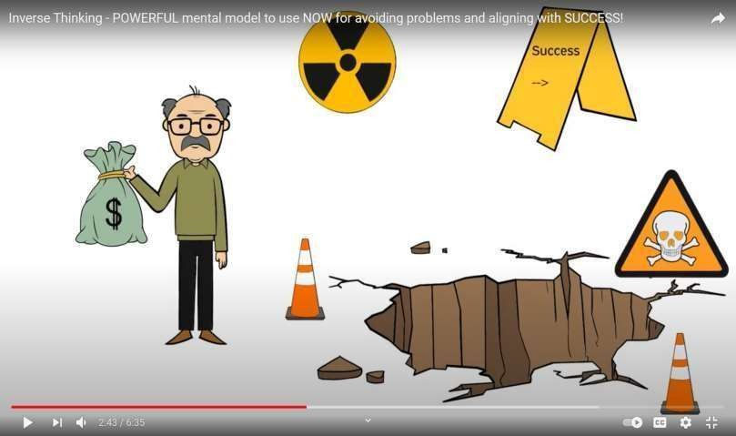

Slide 147
based on belief, not facts
users' thinking is closely related
predictions about the system
future actions

Slide 148
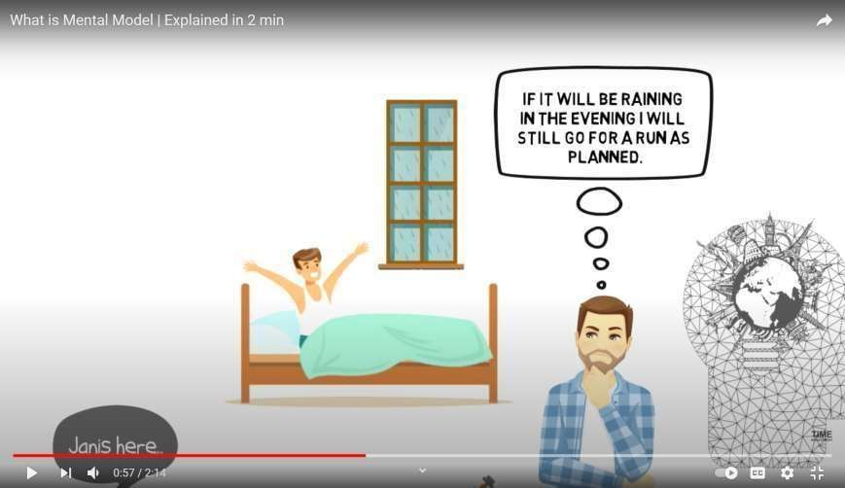

Slide 149
Mental model in UX
“what the user believes about the system at hand.”
Mental models are built in a user’s brain .
people reference them to make their lives easier.
what users will expect from the system

Slide 150
certain UX conventions
Links will be underlined or be written in a different color text
Buttons will appear in a colored box
Search boxes will appear in the upper right hand corner of a website
Logos will appear in the upper left hand corner of a website
Site-wide navigation will appear at the top or left-hand side of a website.

Slide 151
How to determine users’ existing mental models
card sorting
user interviews
Surveys

Slide 152
Task analysis
What’s the Purpose of Task Analysis?
A task analysis is a way to examine carefully exactly how a person performs a certain activity, usually a life skill. It breaks down the activity into a series of tasks, which are observable actions or behaviors.

Slide 153
Steps in task analysis
Knowing Your Audience
Break It Down
Break It Down Further
Consider Variables

Slide 154
conceptual model
What is Conceptual model?
fundamental objectives
Advantages of Conceptual Modeling
Disadvantages of Conceptual Modeling
“As simple as possible, but no simpler—Albert Einstein”

Slide 155
Guidelines for Designing Conceptual Models
Reflect the user’s mental model, not the designer’s.
Draw physical analogies or present metaphors.
Comply with expectancies, habits, routines, and stereotypes.
Provide action-response compatibility.
Make invisible parts and process of a system visible.
Provide proper and correct feedback.
Avoid anything unnecessary or irrelevant.
Provide design consistency.
Provide documentation and a help system that will reinforce the
conceptual model.
Promote the development of both novice and expert mental models.

Slide 156
Defining Objects
Determine all objects that have to be manipulated to get work done.
Describe:
The objects used in tasks.
Object behavior and characteristics that differentiate each kind of
object.
The relationship of objects to each other and the people using them.
The actions performed.
The objects to which actions apply.
State information or attributes that each object in the task must preserve, display,
or allow to be edited.

Slide 157
Developing Metaphors
Choose the analogy that works best for each object and its actions.
Use real-world metaphors.
Use simple metaphors.
Use common metaphors.
Multiple metaphors may coexist.
Use major metaphors, even if you can’t exactly replicate them visually.
Test the selected metaphors.

Slide 158
Design Standards
Value of Standards and Guidelines
Developing and applying design standards or guidelines achieves design consistency.
This is valuable to users because the standards and guidelines:
Allow faster performance.
Reduce errors.
Reduce training time.
Foster better system utilization.
Improve satisfaction.
Improve system acceptance.

Slide 159
They are valuable to system developers because they:
Increase visibility of the human-computer interface.
Simplify design.
Provide more programming and design aids, reducing programming time.
Reduce redundant effort.
Reduce training time.
Provide a benchmark for quality control testing.

Slide 160
An alternative design solution was better than that mandated by the standard.
Available development tools did not allow compliance with the standard.
Compliance with the standard was planned, but time was not yet available to
implement it.
The rule that was broken was not known or was overlooked.

Slide 161
Web Guidelines and Style Guides
Web interface design issues have also unleashed a plethora of Web-specific design guidelines and style guides, many of which are found on the Web itself. These guidelines can be seen on the
sites of the various computer
companies and interface consulting firms, in newsletters, and
even on personal Web sites. While many of the traditional interface guidelines are applicable in a Web environment, the Web does impose a host
of additional considerations.

Slide 162
Document Design
Include checklists to present principles and guidelines.
Provide a rationale for why the particular guidelines should be used.
Provide a rationale describing the conditions under which various design alternatives
are appropriate.
Include concrete examples of correct design.
Design the guideline document following recognized principles for good document
design.
Provide good access mechanisms

Slide 163
Design Support and Implementation
Use all available reference sources in creating the guidelines.
Use development and implementation tools that support the guidelines.
Begin applying the guidelines immediately.

