Slide 1
SUB: “CONSTRUCTION TECHNOLOGY FOR SUB STRUCTURES AND SUPERSTRUCTURES”
SUB CODE:21CV72

Slide 2
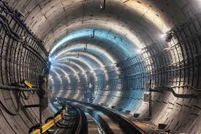
MODULE 1
Underground Construction : Underground– Tunnel-Shaft, Sinking and construction, Micro Tunneling, Tunnel driving in hard and soft strata, bedding of conduits, Soil excavation and Compaction Technology

Slide 3
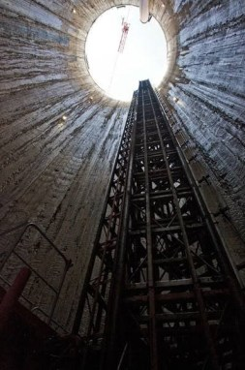
Tunnel shafts are vertical passages that connect the ground surface to the tunnel roof.
Shafts have many advantages and are used in constructing tunnels. When the position and course of the tunnel are correctly aligned and accordingly set out on the surface, shafts are sunk at defined points on the tunnel line to aid tunneling operations.

Slide 4
Shapes of Tunnel Shafts
The tunnel shafts are generally circular or rectangular in shape. The rectangular shape may be adopted for temporary shafts, which are filled up after the tunnel's construction. The permanent shafts are lined with pressed steel linear plates or concrete of circular shape.

Slide 5
Types of Shafts
Inclined Shafts
Vertical Shafts
Circular Shafts

Slide 6
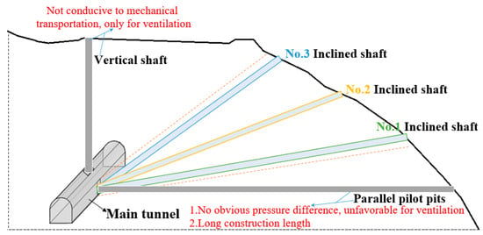
Inclined Shafts
These shafts are used when the shaft depth is less. The excavation of such shafts proceeds in the upward direction. The excavated material falls downward and is removed from the tunnel. The removal of muck by gravity is achieved by using a suitable gradient of 45 degrees or less.

Slide 7
Vertical Shafts
This type of tunnel shaft is usually easier and more economical to excavate when compared to the inclined shaft. In some cases, a pilot shaft is first driven upward before the shaft is excavated to the full section in the downward direction.

Slide 8
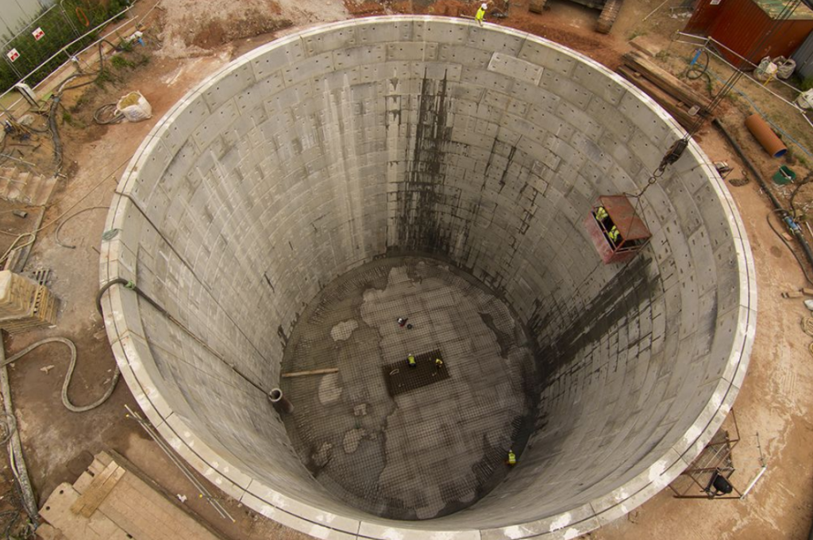
Circular Shafts
These shafts are usually circular and are lined with pre-stressed steel liner plates or concrete.

Slide 9
Tunnel-Shaft Sinking and Construction
Shaft Sinking: This is the process of excavating vertical or near-vertical tunnels (shafts) to reach underground resources or to provide access for tunnel construction. Techniques include:
  Drill and Blast: Used for hard rock where explosives are employed to break up the rock.
  Mechanized Methods: Using machines like tunnel boring machines (TBMs) for softer ground or large-diameter shafts.
  Caisson Method: A water-tight structure (caisson) is sunk into place, and excavation is done inside the caisson.

Slide 10
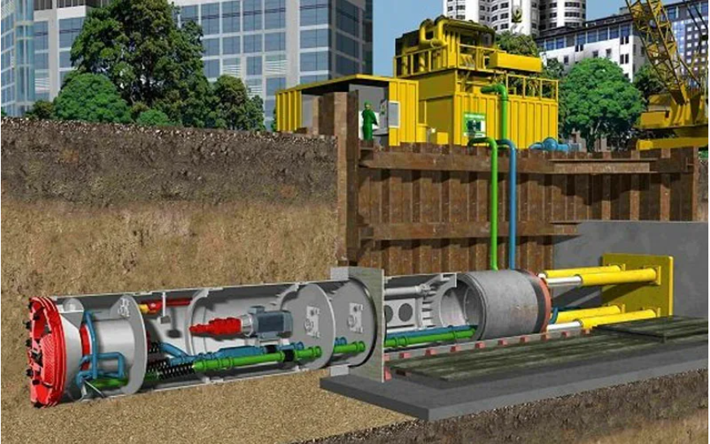
MICRO TUNNELING
Microtunneling is used for constructing small cross-sections under roads, rivers and railways.
Microtunneling is a trenchless construction method used to cross section tunnels without disturbing the surface above. This method is particularly valuable in urban areas where densely populated infrastructure makes traditional open-cut methods challenging. This trenchless construction method is used to install utility pipelines, such as water, sewage, or gas, with reduced impact on surrounding infrastructure and the environment.

Slide 11
How does the microtunneling method work?
The method involves using a microtunnel boring machine (MTBM) to excavate the tunnel while simultaneously installing the pipeline. The MTBM is guided by a laser system, ensuring precision in tunnel alignment and grade. Spoil (excavated material) is typically removed through a slurry system or a pipe conveyor to the surface. An overview of the method is given below;
1. Site Preparation:
– Identify the entry and exit points for the microtunneling machine.
– Ensure proper access and clearance for the equipment.
2. Pilot Bore:
– Use a pilot drill to create a small-diameter hole along the desired tunnel path.
– The pilot bore establishes the tunnel alignment for the larger microtunneling machine.

Slide 12
3. Assembly of Microtunneling Machine:
– Set up and assemble the microtunneling machine, including the cutting head, jacking system, and pipe-handling equipment.
4. Launch Shaft Construction:
– Build a launch shaft at the starting point, providing access for the microtunneling machine.
5. Installation of Pipe Sections:
– Connect pipe sections at the launch shaft.
– These pipes are pushed into the ground as the microtunneling machine progresses.
6. Microtunneling Machine Operation:
– Start the microtunneling machine, which excavates soil using a cutting head and simultaneously installs the pipe.
7. Jacking System:
– Utilize hydraulic jacks or other systems to push the microtunneling machine forward.
– The jacking force is carefully controlled to prevent excessive soil displacement.
8. Spoil Removal:
– Transport excavated soil (spoils) through the tunnel to the launch shaft using a slurry or other appropriate conveyance system

Slide 13
9. Monitoring and Guidance:
– Continuously monitor the machine’s position, alignment, and performance.
– Adjust the direction and angle as needed to maintain accuracy.
10. Reception Shaft:
--Construct a reception shaft at the tunnel exit point to retrieve the microtunneling machine and complete the pipe installation.
11. Pipe Connection and Testing:
--Connect the installed pipe to the existing network or infrastructure.
--Perform tests to ensure the integrity and functionality of the newly installed pipeline.
12. Site Restoration:
--Backfill the launch and reception shafts, restoring the surface to its original condition.
--Ensure proper site cleanup and restoration.

Slide 14
Types of Tunnel Shafts based on Nature of Soil
1. Shafts in rock/hard soil
2. Shafts in soft ground

Slide 15
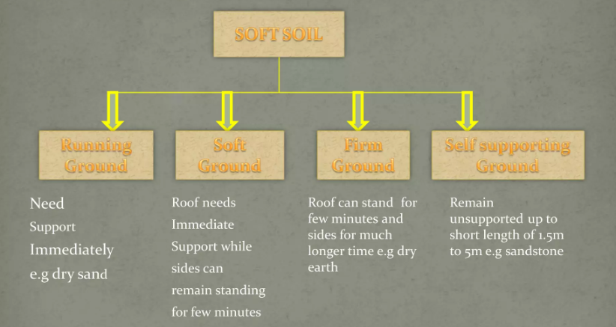
Tunnel Driving in Hard and Soft Strata

Slide 16
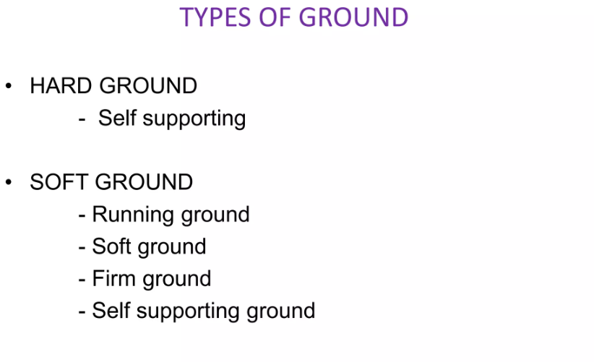

Slide 17
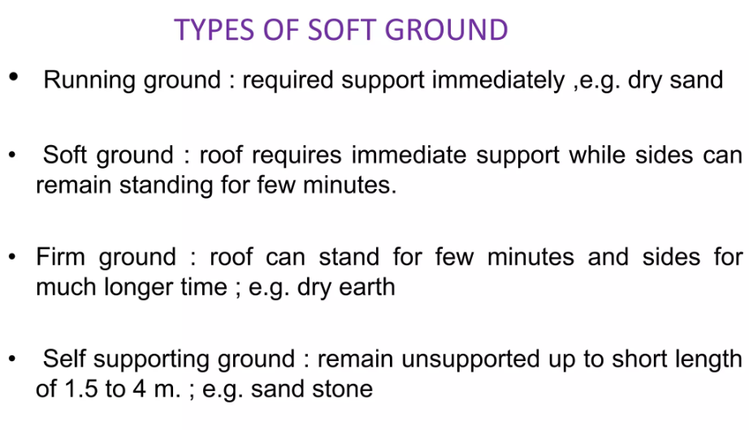

Slide 18
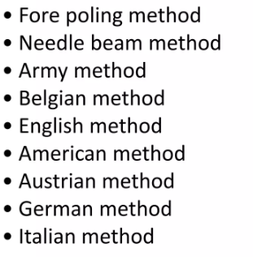
Methods of Tunneling Soft soil

Slide 19
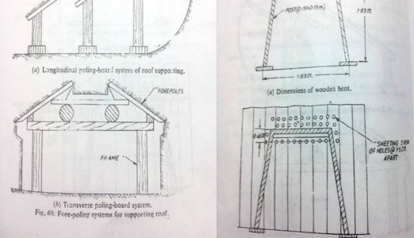
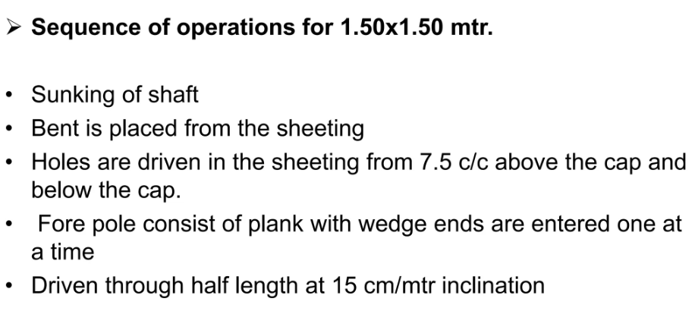
Fore Polling Method:

Slide 20
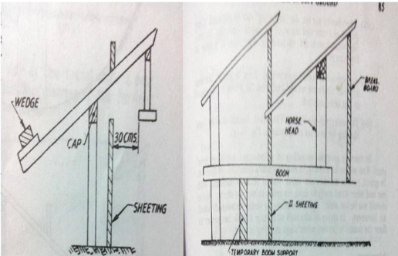
Timber laid at the end of all splices
Face sheeting, broken out and ground is allowed to run.
Put temporary supports at end called Horsehead.
And the other end of forepole is supported with board of size 45 centimetre.
Now repeat the procedure and inserted boom for the support of board.
MERITS:
Used without compressed air.
Used for small dimensions in running ground.
DMERITS:
Slow process.
Used only for small cross section.

Slide 21
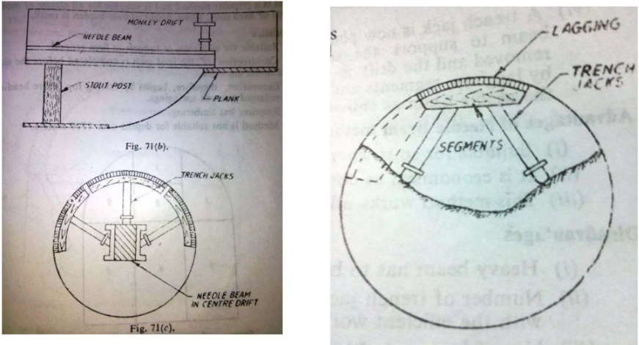
NEEDLE BEAM

Slide 22
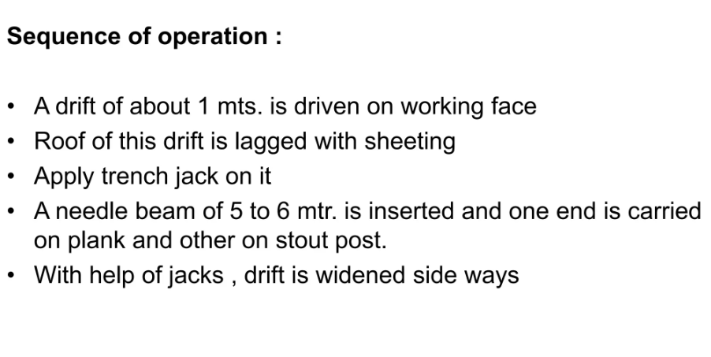
It consists of stout timber beam from main temporary support.
It is used when the soil roof can stand for a few minutes.

Slide 23
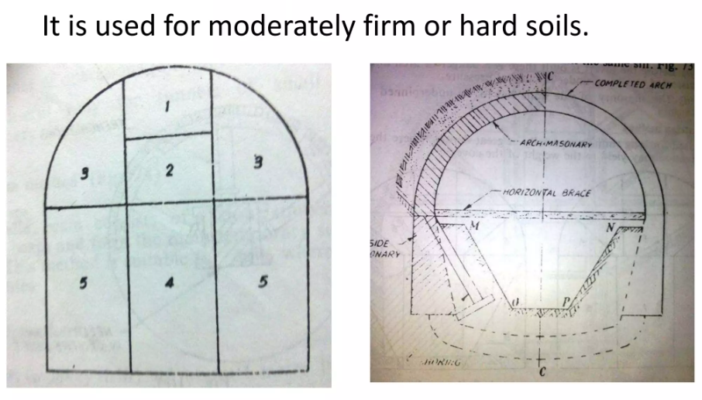
BELGIAN METHOD

Slide 24
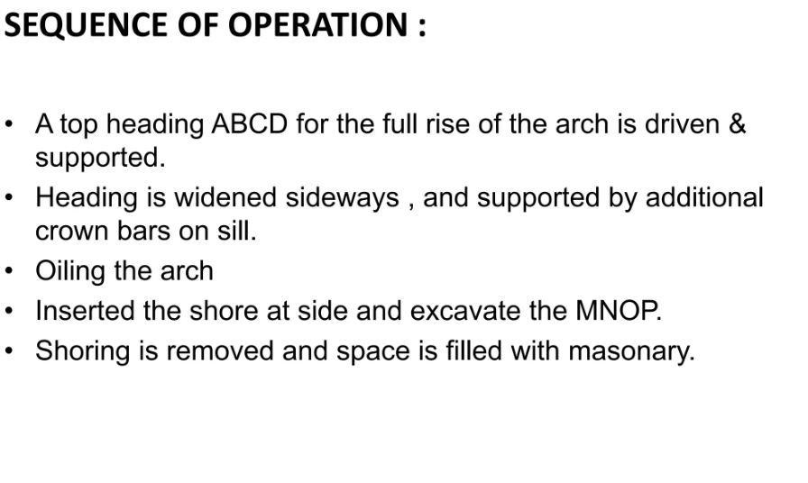

Slide 25
Bedding of Conduits
Conduit Bedding: Involves placing and securing pipes or other conduits in trenches or tunnels to ensure stability and longevity. Bedding materials typically include:
  Gravel: Provides support and drainage.
  Sand: Used for its ability to provide a firm base while allowing minor adjustments in the conduit alignment.
Compaction: The process of compressing the bedding material to remove air pockets and increase its load-bearing capacity.

Slide 26
Soil Excavation and Compaction Technology
Soil Excavation: The removal of soil to create a space for underground construction. Techniques include:
  Hand Tools: For precise excavation in small or sensitive areas.
  Excavators: Heavy machinery for large-scale excavation.
  Hydro Excavation: Uses pressurized water to break up soil, which is then vacuumed away.
Soil Compaction: The process of increasing the density of soil by reducing the air gaps, making it more stable. Methods include:
  Vibratory Compaction: Using a vibrating roller or plate to compact soil.
  Static Compaction: Using the weight of the machinery to compress the soil.
  Dynamic Compaction: Dropping heavy weights onto the soil surface to increase density.

Slide 27
Sinking and Construction of Tunnel Shafts
  Shaft sinking is the process of excavating vertical or near-vertical tunnels, called shafts, from the surface to underground workspaces, which are used for access, ventilation, drainage, or material removal during underground tunnel construction.
  This is a critical part of underground infrastructure development, such as for mining, civil works, or transportation systems

Slide 28
Detailed look at the sinking and construction process
1. Preparation for Shaft Sinking:
Before sinking begins, several factors are carefully considered:
Geological Survey: Analyzing ground conditions (soil, rock, water table) to plan the excavation method and the support systems required.
Design and Planning: Designing the size, shape, and lining of the shaft, accounting for its purpose, depth, and anticipated loads.
Safety Precautions: Identifying potential hazards like water inflow, gas pockets, or unstable ground and planning mitigation strategies.

Slide 29
2. Shaft Sinking Methods
a. Drill and Blast Method
Description: This traditional method is used in hard rock formations. Holes are drilled into the rock face of the shaft, explosives are inserted, and the rock is blasted. The broken rock is removed (called mucking), and then the walls of the shaft are supported temporarily.
Process:
  Drill blast holes into the shaft’s excavation face.
  Load explosives and detonate in a controlled manner.
  Remove the debris (mucking) using winches, buckets, or mechanical devices.
  Install temporary support structures (steel rings or shotcrete) to stabilize the shaft walls.
Challenges: Vibration, noise, and potential damage to surrounding structures, especially in urban environments.

Slide 30
B . Mechanical Sinking (Shaft Boring Machine - SBM)
Description: In this modern approach, a Shaft Boring Machine (SBM) is used to excavate through softer soils or rocks. It works similarly to a Tunnel Boring Machine (TBM) but is designed for vertical shafts.
Process:
  The SBM is lowered into the shaft and starts drilling vertically, removing soil or rock as it advances.
  The machine simultaneously installs concrete or steel segments to line the shaft.
  Continuous removal of muck through conveyor belts or elevators.
Advantages: Quicker and safer than drill and blast, especially in soft or mixed ground conditions.

Slide 31
C. Caisson Sinking (for Waterlogged or Soft Soils)
Description: A caisson is a watertight, pre-cast structure that is sunk into the ground as excavation is performed. This method is often used in wet or soft soil conditions where ground stability is a concern.
Process:
  A large, open-bottomed caisson is placed on the ground surface.
  Soil is excavated from inside the caisson, causing it to sink under its own weight.
  The caisson sinks deeper as more soil is removed, and additional sections are added if necessary.
  Once the final depth is reached, the base is sealed with concrete.
Applications: Ideal for shafts in sandy, clayey, or waterlogged soils.

Slide 32
D. Freezing Method (for Unstable Ground or High-Water Inflow)
Description: In this method, the soil around the shaft is artificially frozen to provide temporary support and prevent water from flowing into the excavation.
Process:
  A series of pipes (freeze pipes) are drilled around the perimeter of the shaft.
  A freezing agent (liquid nitrogen or brine) is circulated through the pipes, freezing the surrounding soil.
  Excavation proceeds within the frozen ring of soil, which remains stable during the sinking.
  After reaching the desired depth, the shaft is lined and the soil is thawed.
Applications: Used in shafts with unstable soils or high groundwater levels.

Slide 33
3. Muck Removal
Muck removal (or mucking) is the process of removing excavated material (rock, soil, etc.) from the shaft. This is typically done using:
Buckets or Skips: Attached to winches or cranes, these buckets carry muck to the surface.
Conveyor Belts: In mechanized shaft sinking, muck can be continuously removed via conveyor systems.
Elevators: Used to transport muck to the surface in larger projects.

Slide 34
4. Groundwater Control and Dewatering
Groundwater can be a major issue in shaft sinking, especially if the shaft is below the water table. Dewatering techniques are used to control water inflow:
Well Points: Multiple small wells are drilled around the shaft, and water is pumped out to lower the water table.
Sump Pumps: Water collecting at the base of the shaft is pumped out using sump pumps.
Grouting: In cases of water inflow, cement or chemical grout can be injected into surrounding soils to form a barrier against water ingress.

Slide 35
5. Shaft Lining
Once the shaft is excavated, permanent lining is installed to ensure the long-term stability of the structure. This lining is also important to prevent groundwater from entering the shaft. Common materials used for lining include:
Concrete Segments: Precast concrete rings are lowered into the shaft and assembled to line the walls.
Shotcrete: Sprayed concrete is applied to the walls for quick, strong support.
Steel Liners: In some cases, steel panels or rings are used, particularly in high-pressure or deep shafts

Slide 36
6. Finishing and Maintenance
Once the shaft has been fully sunk and lined, it is equipped with ladders, elevators, ventilation systems, and other utilities necessary for its intended use.
Proper maintenance is required to prevent corrosion, water ingress, or structural failure over time.

Slide 37
Applications of Shaft Sinking
Mining: Vertical shafts provide access to underground ore deposits.
Metro/Subway Construction: Shafts are used to access tunnels during excavation, as well as for ventilation and emergency exits.
Utility Tunnels: Used for infrastructure like water, sewage, and energy lines.

Slide 38
Challenges in Shaft Sinking
Water Ingress: One of the biggest issues, especially when shafts extend below the water table.
Ground Stability: Unstable soils or rock layers may require additional support systems.
Environmental Concerns: Blasting and drilling can cause vibration, noise, and potential damage to nearby structures.

Slide 39
Tunnel Driving in Hard and Soft Strata
Tunnel driving methods vary based on the type of ground (strata) encountered:
Tunnel Driving in Hard Strata (Rock Tunneling)
Methods:
  Drill and Blast: A traditional technique where holes are drilled into the rock face, filled with explosives, and blasted to create the tunnel.
  Tunnel Boring Machine (TBM): A mechanized system that cuts through rock using a rotating cutterhead equipped with cutting tools (discs or rollers). TBMs are designed for long tunnels in hard rock with minimal need for support during excavation.
Challenges in Hard Strata:
  High stress and vibrations during blasting can affect nearby structures.
  Water inflow from fractures or faults in the rock.
  Difficulties in transporting large pieces of rock from the excavation.

Slide 40
Tunnel Driving in Soft Strata (Soil Tunneling)
Methods:
  Shield Tunneling: A protective shield is used to support the tunnel face during excavation, preventing collapse in soft soils.
  Earth Pressure Balance (EPB) TBM: Commonly used for soft ground tunneling. The machine maintains stability by balancing the pressure at the tunnel face with excavated soil to prevent collapse.
  Slurry Shield TBM: Uses a slurry (bentonite) to support the tunnel face, commonly used in waterlogged soils or weak strata.
Challenges in Soft Strata:
  Soil instability and collapse.
  Managing groundwater inflows.
  Settlement or ground displacement at the surface, which can affect structures above.
Ground Support: In soft ground, immediate support such as shotcrete (sprayed concrete), rock bolts, or steel ribs may be required to prevent collapse during excavation

Slide 41
THANK YOU

