Slide 1
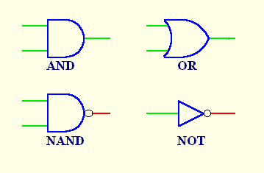
Digital Design and Computer Organization – BCS302
                Course Coordinator:
                Prof. Yogesh N
                Assistant Professor
                Dept. of CSD
                ATMECE, Mysuru
YN
Prof. Yogesh N, Dept. of CSD, ATMECE
1

Slide 2
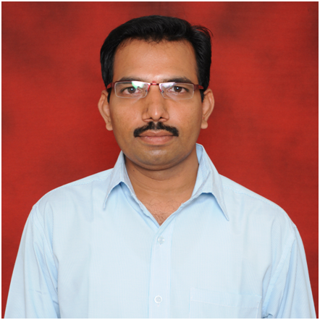
Course Instructor Profile
Prof. Yogesh N
Designation | Assistant Professor
Qualification | B.E, MTech., PGDAC, (Ph.D)
Email Id | yogeshn_cg@atme.edu.in yogeshneelappa.atme@gmail.com
Contact Number | 9663170150
Office hours | 9am – 5pm
Virtual Office hours | 6pm – 8pm
Yogesh N Profile
YN
Prof. Yogesh N, Dept. of CSD, ATMECE
2

Slide 3
Course Overview
Everything that works on batteries around you; and everything that can have a circuit board, is built by using principles of Digital electronics and Digital Logic design.
Digital electronics deals with circuits that operate on digital inputs and outputs.
In this course, we will begin by getting to the bottom of what it means to be digital. How digital values are manipulated by circuits. Eventually, we will progress to the memory aspect of digital electronics. We will understand the function of basic digital circuits like adders, subtractors, multiplexers, decoders, encoders, latches, flip flops, etc.
YN
Prof. Yogesh N, Dept. of CSD, ATMECE
3

Slide 4
Course Overview
The second part of the course will discuss the basic concepts of computer architecture and organization that can help the students to have a clear view as to how a computer system works.
Computer Organization is the way in which a system has to structure its operational units and the interconnections between them that achieve the architectural specifications. It is the realization of the abstract model, and it deals with how to implement the system.
In this course, all the basic to advanced concepts like pipelining, microprogrammed control, computer architecture, instruction design, etc will be discussed.
YN
Prof. Yogesh N, Dept. of CSD, ATMECE
4

Slide 5
Why this Course?
Digital Design and Computer Organization introduces digital design as it applies to the creation of computer systems. It summarizes the tools of logic design and their mathematical basis, along with in depth coverage of combinational and sequential circuits.
Why Digital system is used?
https://www.youtube.com/watch?v=M41M9ATm49M
YN
Prof. Yogesh N, Dept. of CSD, ATMECE
5

Slide 6
Course Information
Digital Design and Computer Organization
Course Code | BCS302
Semester | III Semester
Course Scheme | 2022 Scheme
Teaching Hours/Week (L:T:P:S) | 03 (Lecture) + 02 (Practical)
Total Number of Pedagogy | 40 hours (L) + 20 hours (P)
Credits | 04
CIE Marks | 50
SEE Marks | 50
Total Marks | 100
Exam Hours | 03
YN
Prof. Yogesh N, Dept. of CSD, ATMECE
6

Slide 7
Course Syllabus
Modules
Module-1
Introduction to Digital Design: Binary Logic, Basic Theorems And Properties Of Boolean Algebra, Boolean Functions, Digital Logic Gates, Introduction, The Map Method, Four-Variable Map, Don’t-Care Conditions, NAND and NOR Implementation, Other Hardware Description Language – Verilog Model of a simple circuit. (Text book 1: 1.9, 2.4, 2.5, 2.8, 3.1, 3.2, 3.3, 3.5, 3.6, 3.9)
Module-2
Combinational Logic: Introduction, Combinational Circuits, Design Procedure, Binary Adder- Subtractor, Decoders, Encoders, Multiplexers. HDL Models of Combinational Circuits – Adder, Multiplexer, Encoder. Sequential Logic: Introduction, Sequential Circuits, Storage Elements: Latches, Flip-Flops. (Text book 1: 4.1, 4.2, 4.4, 4.5, 4.9, 4.10, 4.11, 4.12, 5.1, 5.2, 5.3, 5.4)
Module-3
Basic Structure of Computers: Functional Units, Basic Operational Concepts, Bus structure, Performance – Processor Clock, Basic Performance Equation, Clock Rate, Performance Measurement. Machine Instructions and Programs: Memory Location and Addresses, Memory Operations, Instruction and Instruction sequencing, Addressing Modes. (Text book 2: 1.2, 1.3, 1.4, 1.6, 2.2, 2.3, 2.4, 2.5)
YN
Prof. Yogesh N, Dept. of CSD, ATMECE
7

Slide 8
Course Syllabus
Modules
Module-4
Input/output Organization: Accessing I/O Devices, Interrupts – Interrupt Hardware, Enabling and Disabling Interrupts, Handling Multiple Devices, Direct Memory Access: Bus Arbitration, Speed, size and Cost of memory systems. Cache Memories – Mapping Functions. (Text book 2: 4.1, 4.2.1, 4.2.2, 4.2.3, 4.4, 5.4, 5.5.1)
Module-5
Basic Processing Unit: Some Fundamental Concepts: Register Transfers, Performing ALU operations, fetching a word from Memory, Storing a word in memory. Execution of a Complete Instruction. Pipelining: Basic concepts, Role of Cache memory, Pipeline Performance. (Text book 2: 7.1, 7.2, 8.1)
YN
Prof. Yogesh N, Dept. of CSD, ATMECE
8

Slide 9
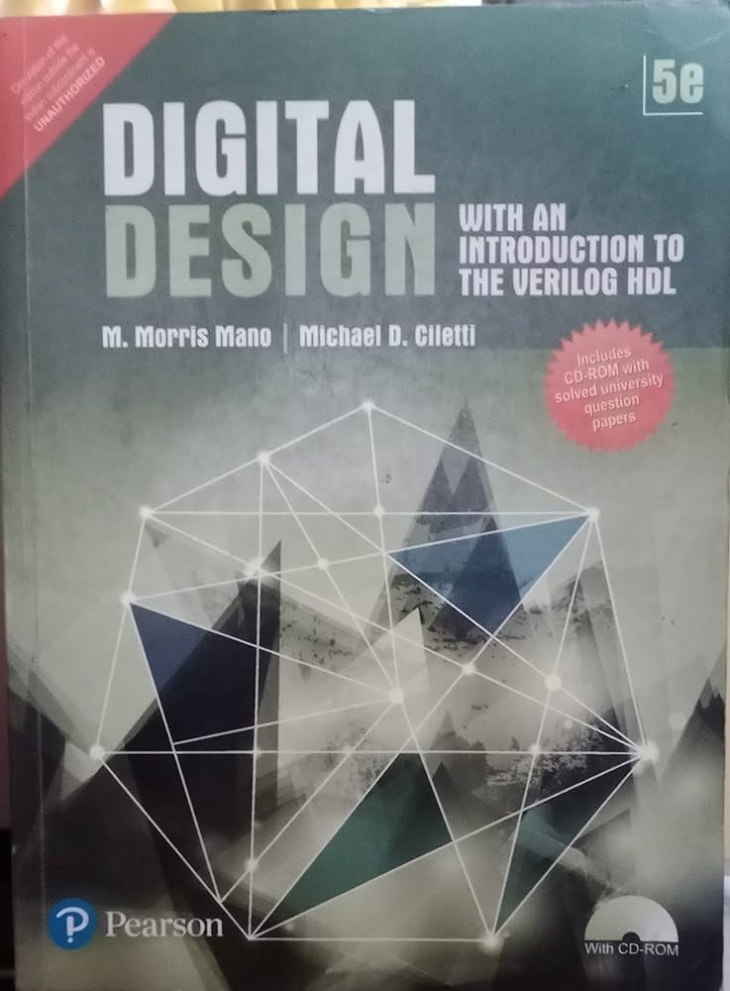
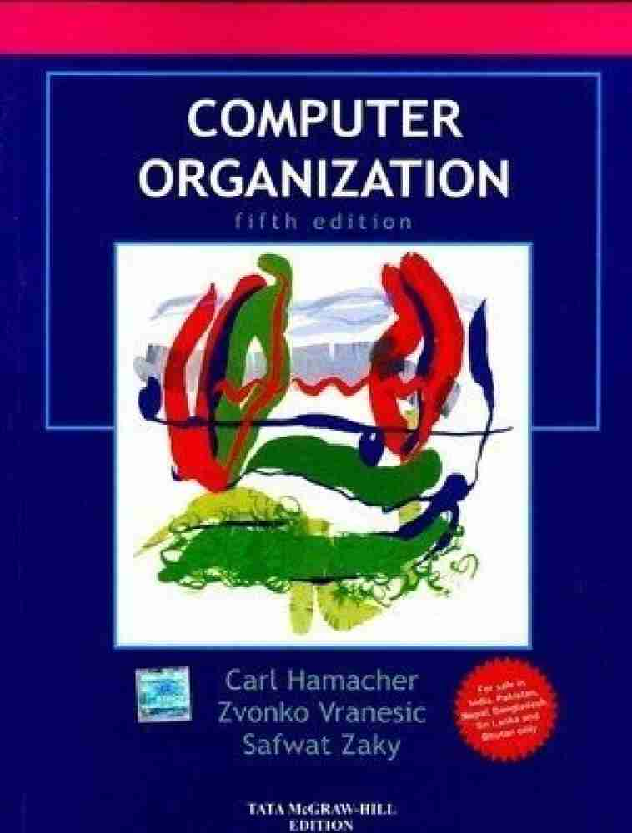
Suggested Learning Resources
Text Books
M. Morris Mano & Michael D. Ciletti, Digital Design With an Introduction to Verilog Design, 5e, Pearson Education.
Carl Hamacher, ZvonkoVranesic, SafwatZaky, Computer Organization, 5th Edition, Tata McGraw Hill.
Web links and Video Lectures (e-Resources)
https://cse11-iiith.vlabs.ac.in/
YN
Prof. Yogesh N, Dept. of CSD, ATMECE
9

Slide 10
Course Learning Objectives (CLOs)
This course will enable students to
CLO 1: To demonstrate the functionalities of binary logic system.
CLO 2: To explain the working of combinational and sequential logic system.
CLO 3: To realize the basic structure of computer system.
CLO 4: To illustrate the working of I/O operations and processing unit.
YN
Prof. Yogesh N, Dept. of CSD, ATMECE
10

Slide 11
Course Outcomes (COs)
At the end of the course, the student will be able to:
CO1: Apply the K–Map techniques to simplify various Boolean expressions.
CO2: Design different types of combinational and sequential circuits along with Verilog programs.
CO3: Describe the fundamentals of machine instructions, addressing modes and Processor performance.
CO4: Explain the approaches involved in achieving communication between processor and I/O devices.
CO5: Analyze internal Organization of Memory and Impact of cache/Pipelining on Processor Performance.
YN
Prof. Yogesh N, Dept. of CSD, ATMECE
11

Slide 12
IPCC Course Structure
IPCC stands for Integrated Professional Core Course.
Integration of both theory and practical in one course.
Dedicated 40 hours (3 hours /week) and 20 hours (2 hours /week) is allotted in the integrated course.
Each module in the course is connected with a laboratory component.
To conduct Practical sessions, the Multisim, Modelsim, PSpice or any relevant softwares are used.
Softwares are available with license or as an open source softwares.
YN
Prof. Yogesh N, Dept. of CSD, ATMECE
12

Slide 13
Laboratory Component
Sl. No. | Experiments Simulation packages preferred: Multisim, Modelsim, PSpice or any other relevant
1 | Given a 4-variable logic expression, simplify it using appropriate technique and simulate the same using basic gates.
2 | Design a 4 bit full adder and subtractor and simulate the same using basic gates.
3 | Design Verilog HDL to implement simple circuits using structural, Data flow and Behavioural model.
4 | Design Verilog HDL to implement Binary Adder-Subtractor – Half and Full Adder, Half and Full Subtractor.
5 | Design Verilog HDL to implement Decimal adder.
6 | Design Verilog program to implement Different types of multiplexer like 2:1, 4:1 and 8:1.
7 | Design Verilog program to implement types of De-Multiplexer.
8 | Design Verilog program for implementing various types of Flip-Flops such as SR, JK and D.
YN
Prof. Yogesh N, Dept. of CSD, ATMECE
13

Slide 14
Course Assessment Policy
The weightage of Continuous Internal Evaluation (CIE) is 50% and for Semester End Exam (SEE) is 50%.
The minimum passing mark for the CIE is 40% of the maximum marks (20 marks out of 50) and for the SEE minimum passing mark is 35% of the maximum marks (18 out of 50 marks).
A student shall be deemed to have satisfied the academic requirements and earned the credits allotted to each subject/course if the student secures a minimum of 40% (40 marks out of 100) in the sum total of the CIE (Continuous Internal Evaluation) and SEE (Semester End Examination) taken together.
YN
Prof. Yogesh N, Dept. of CSD, ATMECE
14

Slide 15
Course Assessment Policy
CIE for the theory component of the IPCC (maximum marks 50)
IPCC means practical portion integrated with the theory of the course.
CIE marks for the theory component are 25 marks and that for the practical component is 25 marks.
25 marks for the theory component are split into 15 marks for two Internal Assessment Tests (Two Tests, each of 15 Marks with 01-hour duration, are to be conducted) and 10 marks for other assessment methods. The first test at the end of 40-50% coverage of the syllabus and the second test after covering 85-90% of the syllabus.
Scaled-down marks of the sum of two tests and other assessment methods will be CIE marks for the theory component of IPCC (that is for 25 marks).
The student has to secure 40% of 25 marks to qualify in the CIE of the theory component of IPCC. (i.e., 10 marks).
YN
Prof. Yogesh N, Dept. of CSD, ATMECE
15

Slide 16
Course Assessment Policy
CIE for the practical component of the IPCC
15 marks for the conduction of the experiment and preparation of laboratory record, and 10 marks for the test to be conducted after the completion of all the laboratory sessions.
On completion of every experiment/program in the laboratory, the students shall be evaluated including viva-voce and marks shall be awarded on the same day.
The CIE marks awarded in the case of the Practical component shall be based on the continuous evaluation of the laboratory report. Each experiment report can be evaluated for 10 marks. Marks of all experiments’ write-ups are added and scaled down to 15 marks.
The laboratory test (duration 02/03 hours) after completion of all the experiments shall be conducted for 50 marks and scaled down to 10 marks.
Scaled-down marks of write-up evaluations and tests added will be CIE marks for the laboratory component of IPCC for 25 marks.
The student has to secure 40% of 25 marks to qualify in the CIE of the practical component of the IPCC. (i.e., 10 marks).
YN
Prof. Yogesh N, Dept. of CSD, ATMECE
16

Slide 17
Course Assessment Policy
SEE for IPCC
Theory SEE will be conducted by University as per the scheduled timetable, with common question papers for the course (duration 03 hours).
The question paper will have ten questions. Each question is set for 20 marks.
There will be 2 questions from each module. Each of the two questions under a module (with a maximum of 3 sub-questions), should have a mix of topics under that module.
The students have to answer 5 full questions, selecting one full question from each module.
Marks scored by the student shall be proportionally scaled down to 50 Marks.
The theory portion of the IPCC shall be for both CIE and SEE, whereas the practical portion will have a CIE component only. Questions mentioned in the SEE paper may include questions from the practical component.
YN
Prof. Yogesh N, Dept. of CSD, ATMECE
17

Slide 18
Applications
Mobile Phones, Calculators and Digital Computers
Radios and communication Devices
Signal Generator
Smart Card
Cathode Ray Oscilloscope(CRO)
Analog to digital converters (ADC)
Digital to analog converters (DAC)
Digital Stop watch
Simple Combinational lock
YN
Prof. Yogesh N, Dept. of CSD, ATMECE
18

Slide 19
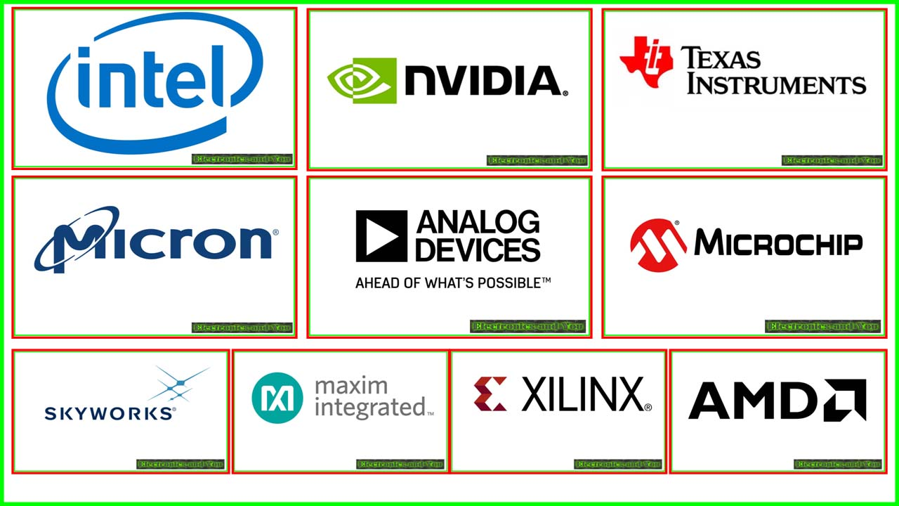

Industries Associated
YN
Prof. Yogesh N, Dept. of CSD, ATMECE
19

Slide 20
Summary
In today’s session, you all have gone through the following topics
Introduction to the course
Course Objectives and Outcomes
Course Syllabus
Course Assessment Policy
Applications (on a nutshell)
Associated Industries/Organizations
YN
Prof. Yogesh N, Dept. of CSD, ATMECE
20

Slide 21

Discussion and Interaction
YN
Prof. Yogesh N, Dept. of CSD, ATMECE
21

Slide 22
Topics for Next Session
Bridge Course
Number Systems
Digital Logic
YN
Prof. Yogesh N, Dept. of CSD, ATMECE
22

Slide 23


YN
Prof. Yogesh N, Dept. of CSD, ATMECE
23

